Slide 1
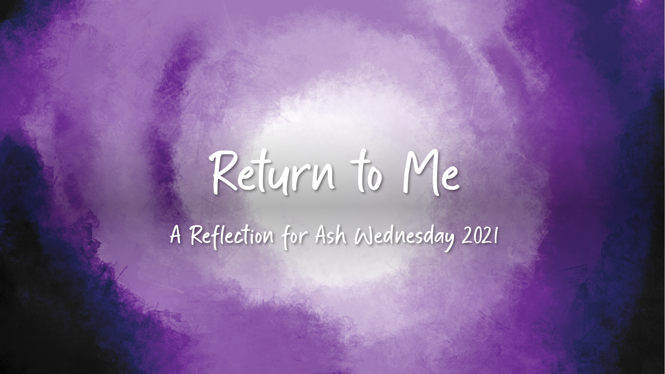
Notes:
Welcome
Leader Notes: Welcome your group to the service and create a sense of community before prayer by starting conversation with questions. You could use the following questions and ask folks to utilize the chat function or general room discussion.
What was the most difficult thing you ever gave up for Lent?
What was the most beneficial Lenten observance you have taken on?

Slide 2
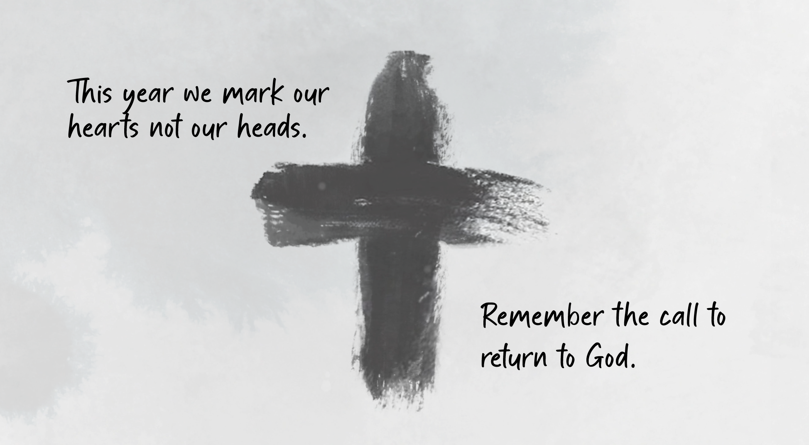
Notes:
Call to Prayer
Leader In the Gospel for Ash Wednesday, Jesus tells his followers not to show off their fasting and to pray in the inner rooms of their homes. These words take on new meaning this year - unable to be marked by ashes, restricted to our homes, our prayers are private but no less fervent. This year we mark our hearts and not our heads. May the loss of traditional Ash Wednesday observance be the first thing we let go in deepening our Lenten journey. Remember the call to return to God,

Slide 3
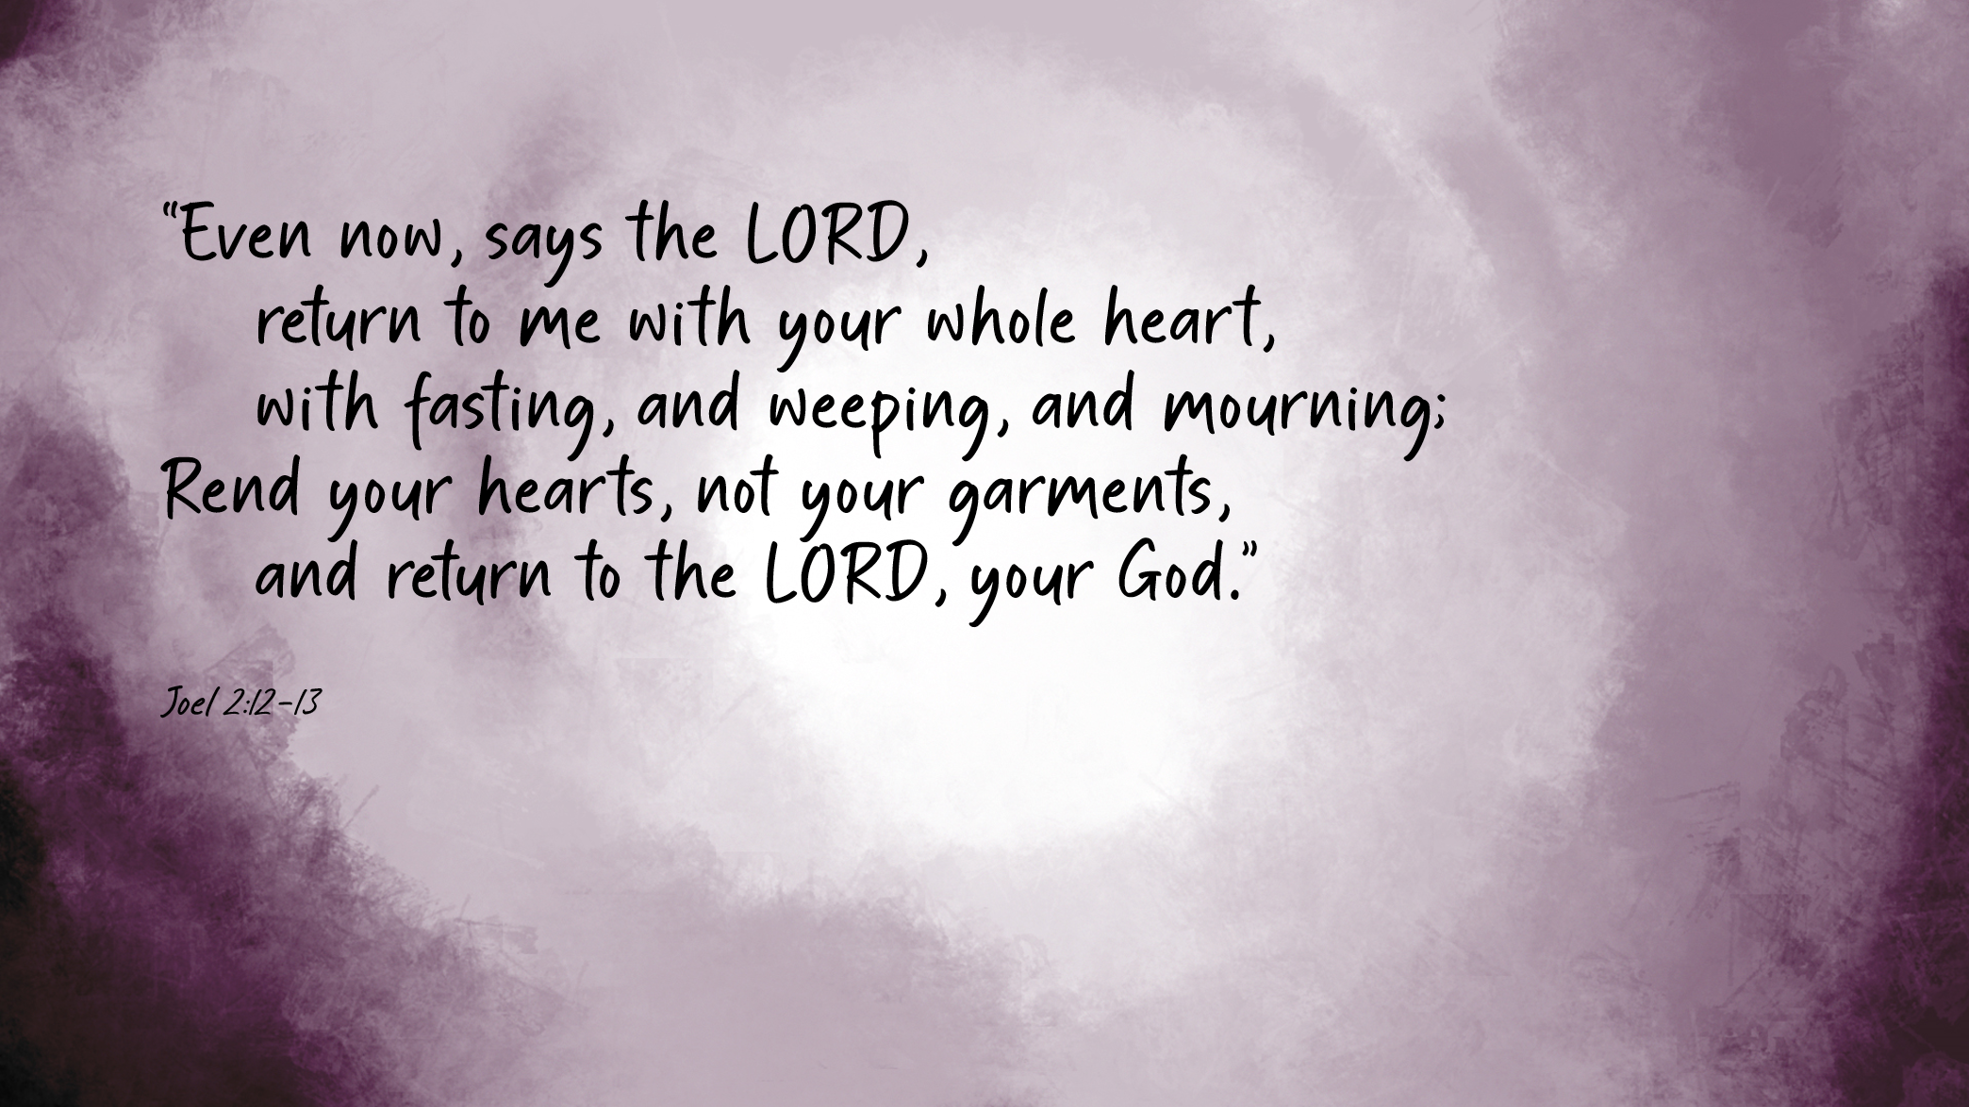
Notes:
Scripture
Reader A reading from the prophet Joel
“Even now, says the LORD,
return to me with your whole heart,
with fasting, and weeping, and mourning;
Rend your hearts, not your garments,
and return to the LORD, your God.”
The Word of the Lord
Thanks be to God
Joel 2:12-13

Slide 4
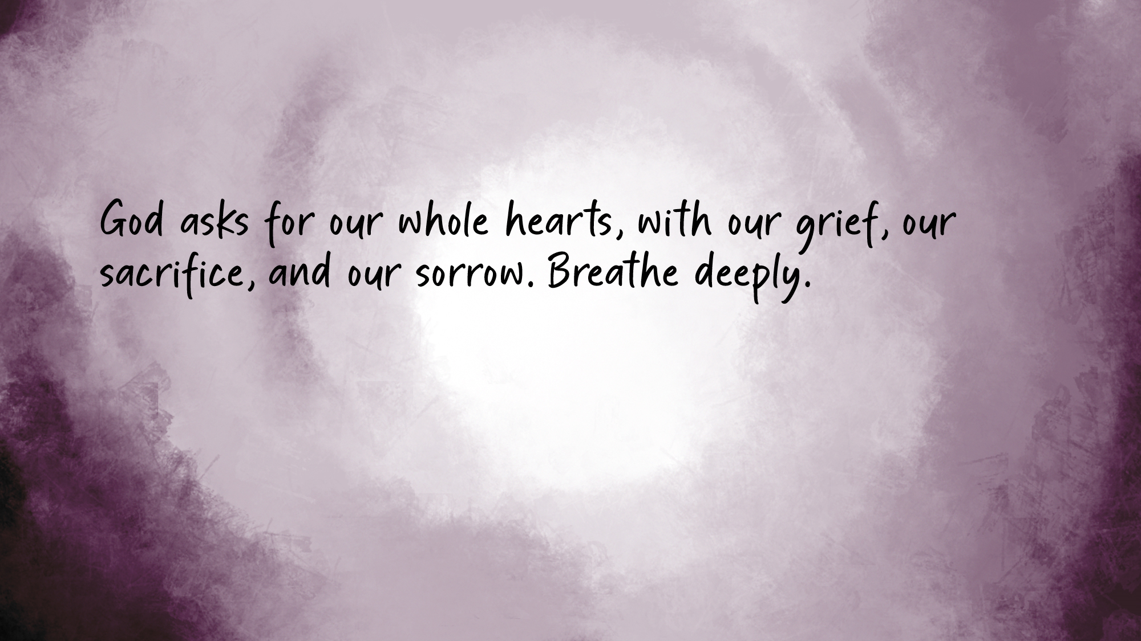
Notes:
Guided Reflection
Leader Notes – Space this section out for it to take 2-3 minutes or more at a reflective pace. If you feel the questions are too deep or probing, feel free to modify them. If you would like to utilize group reflection of sharing this is a good opportunity to do so via discussion, chat or breakout rooms depending on the size of the group gathered.
Leader God asks for our whole hearts, with our grief, our sacrifice, and our sorrow. Breathe deeply. Be mindful of your inhale and your exhale.
Visualize yourself. How do you come before the God this year on Ash Wednesday? What posture most represents your inner spirit?
In the inner room of your heart, ask yourself what limits do you put on God’s love of you?
What is standing between you and the God who knows and loves you?
How will you use this Lent to remove your limitations on God’s love? How will you use this Lent to move closer to God who made, loves and cares for you?

Slide 5
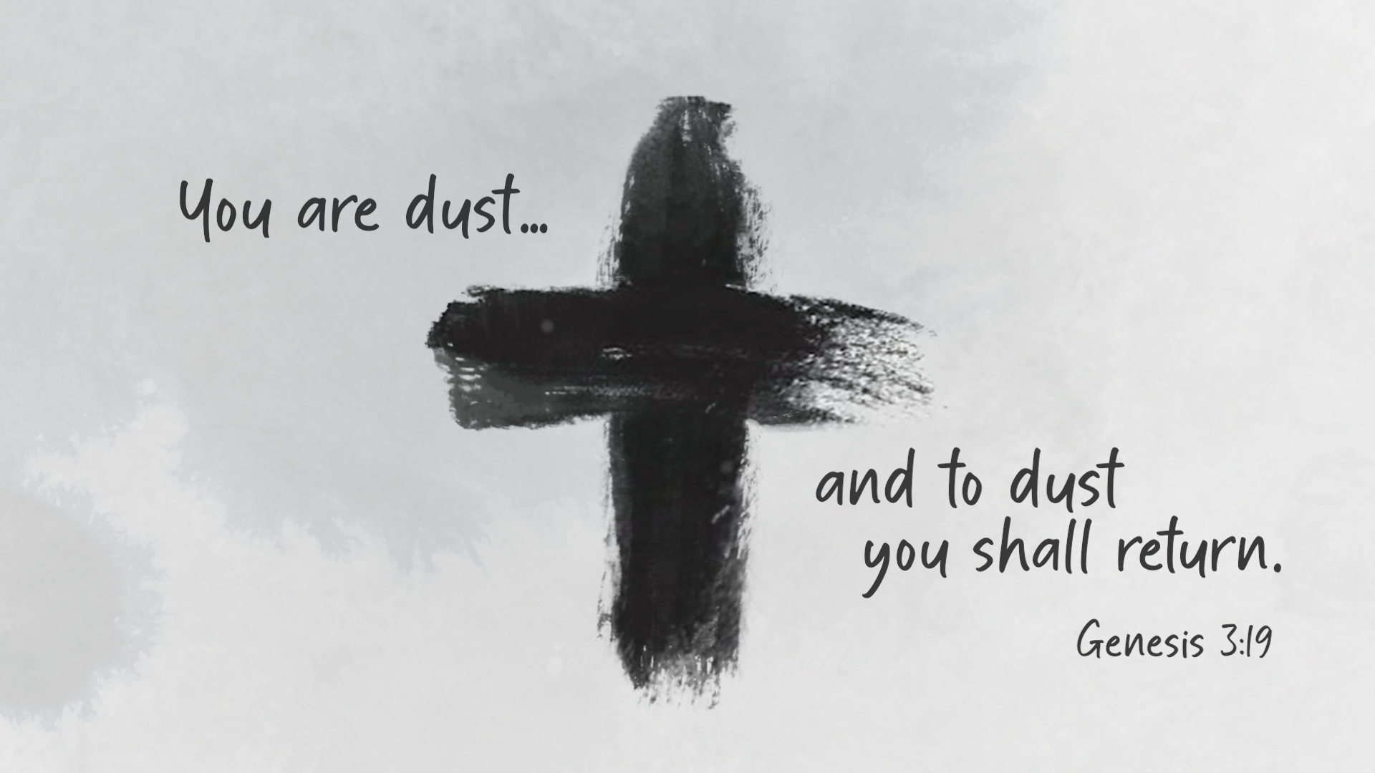
You are dust and to dust you shall return.
Notes:
Ritual Marking with Ashes
Leader As we begin our walk with Jesus to the cross and resurrection, we unite our mortality and limits to Christ’s own suffering and passion in order that we might enjoy his divine life as well. To mark the beginning of your journey this Lent, trace a cross on your forehead and repeat the ancient words,
You are dust and to dust you shall return.

Slide 6
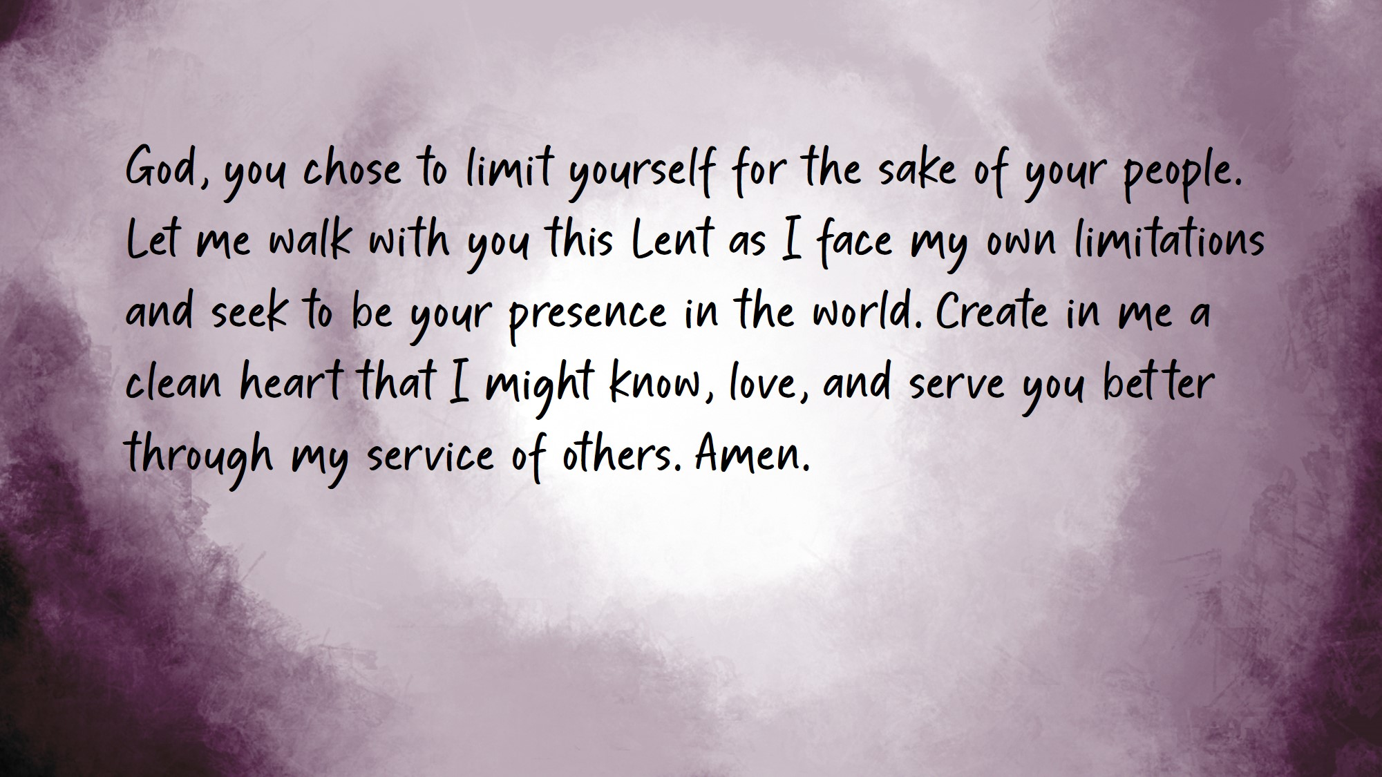
Notes:
Leader Note: Invite folks to speak the prayer aloud where they are but remain on mute.
Closing Prayer
Leader God, you chose to limit yourself for the sake of your people.
Let me walk you this Lent as I face my own limitations and seek to be your presence in the world.
Create in me a clean heart that I might know, love, and serve you better through my service of others. Amen.

