Slide 1



Slide 2
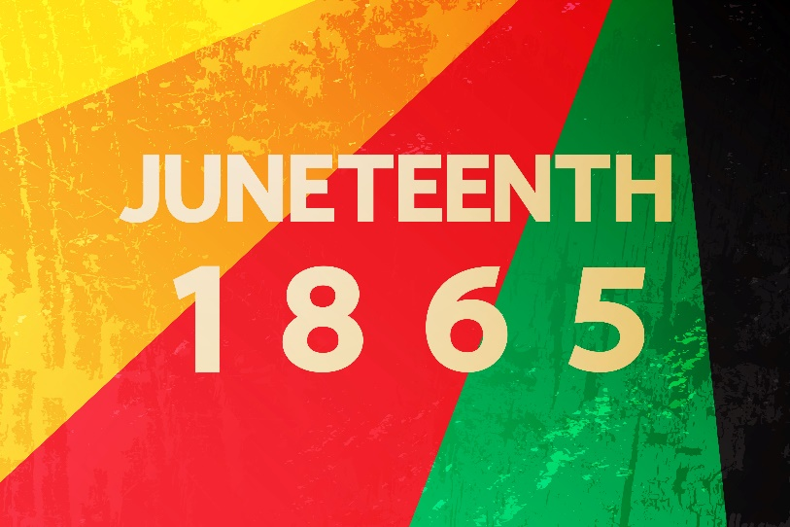
A Prayer for Juneteenth
God of all peoples, of all nations,
On this day of freedom, we celebrate triumphantly with all people of goodwill that we might walk arm in arm towards justice for all.
Breathe into us your eternal breath, that we may never tire of ensuring a flourishing life for all people, but most especially, those brothers and sisters whose growth has been stifled by the trauma of being enslaved.
O God, we know and have seen your goodness, and because of it, we cling to the hope that unity and liberation for all are within our grasp. Continue to show us your goodness, that we may have the strength to advance your kingdom with humility and grace.
Through Christ our Lord, we pray,
Amen.

