Slide 1
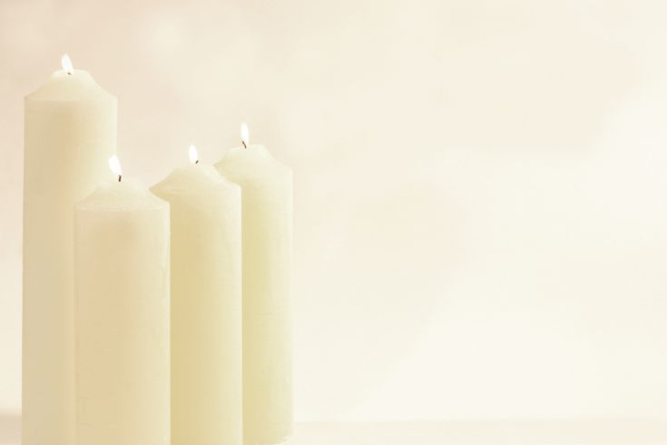
Memorial Prayer Service for Health Care Workers Lost Due to COVID 19
© The Catholic Health Association of the United States

Slide 2
Leader: In the name of the Father, and of the Son, and of the Holy Spirit
ALL: Amen.
Leader: The grace of our Lord Jesus Christ, the love of God, and the communion of the Holy Spirit be with you all.
ALL: And with your spirit.
© The Catholic Health Association of the United States

Slide 3
Leader: Brothers and sisters, we gather this day to honor our colleagues who have lost their lives in service to their vocation. We mourn their passing deeply, and know that, while there are no words for the suffering we have endured as a community, you know what is written on our hearts. As such, we seek to memorialize the sacrifice of these members of our community we have lost and to celebrate their lives lived for others. I invite you to bow your heads and pray together with me …
© The Catholic Health Association of the United States

Slide 4
Collect
Leader:
Lord God, you are attentive to the voice of our pleading. Let us find in your Son comfort in our sadness, certainty in our doubt, and courage to live through this season. Make our faith strong through Christ our Lord.
ALL: Amen.
© The Catholic Health Association of the United States

Slide 5
Reading: Wisdom 3: 1-3, 7-9
A reading from the book of Wisdom:
“The souls of the righteous are in the hand of God, and no torment shall touch them. They seemed, in the view of the foolish, to be dead; and their passing away was thought an affliction and their going forth from us, utter destruction. But they are in peace.
In the time of their judgment they shall shine and dart about as sparks through stubble; They shall judge nations and rule over peoples, and the LORD shall be their King forever.
Those who trust in him shall understand truth, and the faithful shall abide with him in love: Because grace and mercy are with his holy ones, and his care is with the elect.”
The Word of the Lord
ALL: Thanks be to God.

Slide 6
Psalm: Psalm 121
Side 1:
I lift up my eyes to the mountains;
from where shall come my help?
My help shall come from the LORD,
who made heaven and earth.
Side 2:
He will keep your foot from stumbling.
Your guard will never slumber.
No, he sleeps not nor slumbers,
Israel’s guard.

Slide 7
Side 1:
The LORD your guard, the LORD your shade
at your right hand.
By day the sun shall not smite you,
nor the moon in the night.
Side 2:
The LORD will guard you from evil;
he will guard your soul.
The LORD will guard your going and coming,
both now and forever.

Slide 8
GOSPEL: John 15: 12-17
A reading from the holy Gospel according to John:
“This is my commandment: love one another as I love you. No one has greater love than this, to lay down one’s life for one’s friends. You are my friends if you do what I command you. I no longer call you slaves, because a slave does not know what his master is doing. I have called you friends, because I have told you everything I have heard from my Father. It was not you who chose me, but I who chose you and appointed you to go and bear fruit that will remain, so that whatever you ask the Father in my name he may give you. This I command you: love one another.”
The Gospel of the Lord.
ALL: Praise to you Lord Jesus Christ.

Slide 9
[optional] Reflection
The leader is invited to craft a brief reflection based on the readings and the experience of trauma, loss and resilience their community has collectively faced.

Slide 10
Litany of the Saints
Please pray with me as we call on the Communion of Saints to intercede on our behalf.
Leader: Let us pray:
Responses italicized
Lord have mercy; Lord have mercy.
Christ have mercy; Christ have mercy.
Lord have mercy; Lord have mercy.

Slide 11
Saint Raphael the Archangel; pray for us.
Saint Michael the Archangel; pray for us.
Saint Luke the Evangelist; pray for us.
Saints Cosmas and Damian; pray for us.
Saint Peregrine; pray for us.
Saint John of God; pray for us.
All you holy men and women: pray for us.
© The Catholic Health Association of the United States

Slide 12
Saint Camillus of Lellis; pray for us.
Saint Rene Goupil; pray for us.
Saint Francis Xavier Cabrini; pray for us.
Saint Gianna Beretta Molla; pray for us.
Saint Catherine of Siena; pray for us.
Saint Martin de Porres; pray for us.
All you holy men and women: pray for us.
© The Catholic Health Association of the United States

Slide 13
Saint Brigid of Ireland; pray for us.
Saint Paul the Apostle; pray for us.
Saint Joseph Moscati; pray for us.
Saint John Francis Regis; pray for us.
Saint Margaret of Cortona; pray for us.
Saint Margaret of Antioch; pray for us.
All you holy men and women: pray for us.
© The Catholic Health Association of the United States

Slide 14
[insert name of the departed here]; pray for us.
[insert name of the departed here]; pray for us.
[insert name of the departed here]; pray for us.
[insert name of the departed here]; pray for us.
[insert name of the departed here]; pray for us.
[insert name of the departed here]; pray for us.
Eternal rest grant unto them, Oh Lord; And may perpetual light shine upon them.
© The Catholic Health Association of the United States

Slide 15
Leader: May the souls of the faithful departed, through the mercy of God, rest in peace.
ALL: Amen.
Leader: Having invoked the intercession of those who have gone before us, and aware that we, too, can always come to God ourselves in prayer, let us pray:

Slide 16
ALL: Our Father, who art in heaven, hallowed be thy name; thy kingdom come; thy will be done on earth as it is in heaven.
Give us this day our daily bread; and forgive us our trespasses as we forgive those who trespass against us; and lead us not into temptation, but deliver us from evil.
For the kingdom, the power and the glory are yours, now and for ever.

Slide 17
Closing prayer and final blessing
Leader: Let us bow our heads and pray for God’s blessing:
Collect
May the peace of God, which is beyond all understanding, keep our hearts and minds in the knowledge and love of God and of his Son, our Lord Jesus Christ.
ALL: Amen.

Slide 18
Leader:
May the love of God and the peace of the Lord Jesus Christ bless and console us and gently wipe every tear from our eyes: in the name of the Father, and of the Son, and of the Holy Spirit.
ALL: Amen.
Leader: Go in the peace of Christ. R. Thanks be to God.

