Slide 1


Slide 2



Webinar Logistics
The webinar is being recorded and will be available on the website in the ‘members only’ portal.
A recording of the webinar and PDF slides will be sent to your email in 1-3 days.
Your phone lines and computer speakers are muted.
We will have time for Q & A at the end.
Use the “Questions” box for your questions.

Slide 3
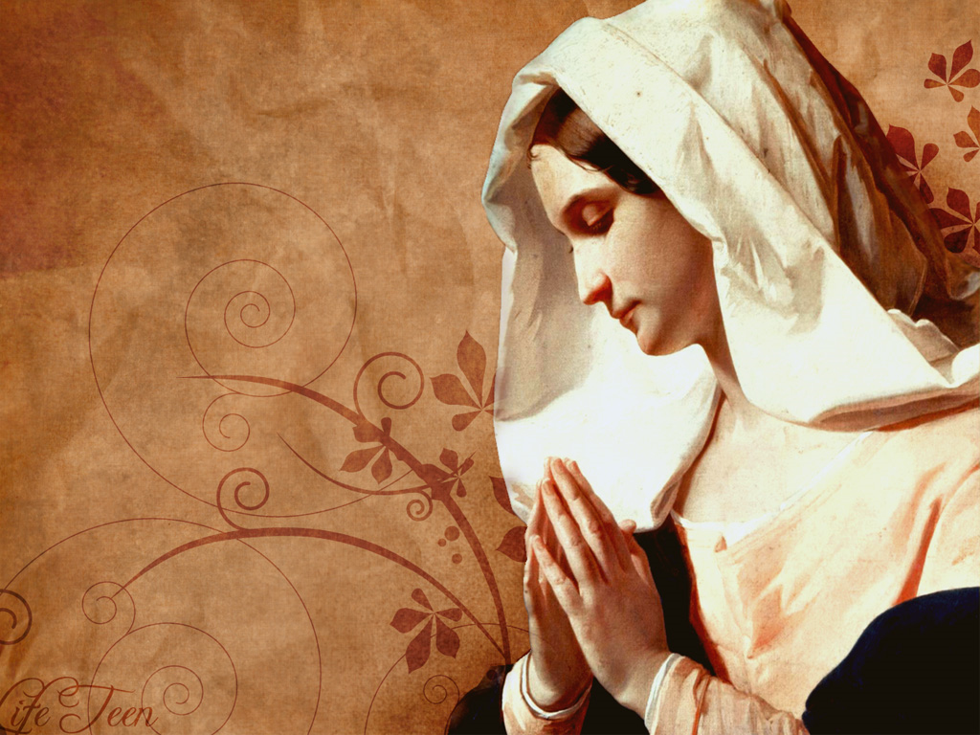
Faith Community Nursing
Deborah Meiklejohn, MNSc, RN
Faith Community Nurse Educator

Slide 4
A Calling
Theology Institute at DOLR
Future Goals
Talked with my Priest about Parish Nursing
2016 Established a Faith and Health Ministry at Our Lady of Good Counsel, Little Rock, AR
October 2016, Faith Community Nursing Foundations Course, by the Westberg Institute at the Archdiocese of Oklahoma City
2019 Started working with Catholic Charities and CHI St. Vincent.
Notes:
Need to get support and approval from the Parish Priest and Deacons.

Slide 5
Initial Committee Members
Sheryl Banak, MSN, RN
Carlita Baquial, RN (Retired)
Janet Breen, LPC
Helen Evans, RN (Retired)
Lilian Felicitas, BSBA
Peter Goulden, MD, FRCP
Diane Hanley, OTR/L
Bernadette Lange, MD
Carla LaMay, LCSW
Anne Mancino, MD
Deborah Meiklejohn, MNSc, RN
Vicki Stefans, MD
Patricia Thompson, PhD, RN
Notes:
Committee is made up of members of the congregation from different professions who oversee the Faith and Health Ministry.
They determine the events that will take place and assist at the events.
After our first couple of years, we now meet only quarterly except in the months preceeding the health fair. They we meet on a monthly basis.

Slide 6
Mission Statement
Work to promote health with an emphasis on the spiritual component where an individual’s awareness of God’s love and care enhances healing and lessen isolation and loneliness (CC, OKC).
Notes:
Adopted from Catholic Charities, Oklahoma City website.

Slide 7
Goals
Care of the sick and frail by meeting physical, spiritual, mental and social needs.
Visits both during and after hospitalization as requested.
Promotion of healthy lifestyles through wellness education.
Support spiritual, social and emotional needs – prayer, support groups.
Assistance accessing healthcare services and resources.
Notes:
These were written by our committee.
Visits during and after hospitalizations are on a request basis only. Some people who are in the hospital want their information to remain confidential.
For some the hardest thing to learn Is that what is said to them is private and they can’t talk about it at church. Especially when someone is talking
About a fellow parishioner who was in the hospital. You can’t interject and add additional information to their conversation. The best thing to do is
Walk away from the conversation.

Slide 8
What is Faith Community Nursing (FCN)?
AKA parish nursing or church nursing.
Earliest documentation of nursing is before Christ.
1970 Dr. Granger Westberg conceptualized FCN
1983 Piloted Parish Nursing in Tucson, AZ
1991 First class for FCN
1997 First published FCN Foundations Book
2019 Last revision date for FCN course

Slide 9
What is Faith Community Nursing (FCN)?
1997 Faith Community Nursing was recognized as a specialty in nursing practice by the American Nurses Association (ANA).
1998/2017 Scopes and Standards of Practice
Combines professional nursing and health in a faith community.
Spiritual aspect is the key to FCN by actively promoting wellness, wholeness and preventive health.

Slide 10
Faith Community Nursing Foundations Course
Gain an understanding of the theoretical knowledge necessary to begin in practice as an FCN.
Professionalism: Various roles of the FCN in practice.
Wholistic: Process multiple aspects of a person including spiritual, physical, social and psychological.
Spiritual: Examine and nurture personal spiritual development.
Community: Identify a network of continuing education and support
Notes:
Spirituality – we share Christ love in our hearts with those who need love through our compassionate care. FCN is an extension pf God’s unconditional love.
Nurses must take care of themselves first so they can serve others. As St. Bernard of Clairvaux said “they must act as a reservoir by filling themselves first with spiritual fullness and love, then sharing the excess of these gifts with others”.
Develop a network of nurses to work together especially in times of emergencies, pandemic vaccines, etc.

Slide 11
Roles of a Faith Community Nurse
Educator
Referral Agent
Advocate
Personal health counselor
Developer of support groups
Volunteer coordinator
Integrator of faith and health
Notes:
Faith community nurses often work alone. 90% of the nurses see this as an opportunity to share their compassion and humility with others.
The role of a FCN is influenced by how a person experiences and understands self, God and healing.
Example of an advocate – Mary Richards, referral for home care assistance, allowed her to make the choices, back at church.
FCN can be an educator for parishioners based on their needs.
They can also educate others who want to help with home visits by setting up a course where they review infection control, confidentiality, communications, etc.

Slide 12
What Can An FCN Do For Their Parish?
Survey the congregation
Health Fair – provide flu shots, B/P checks, blood glucose check, mammogram van, blood drive, etc.
Walking program, fitness class, CPR classes, obtain an AED, first aid, PPE, hand sanitizer, etc.
Support groups – locate locally or start a new support group – grief, mental illness, AA, etc.
Notes:
Introduced the ministry to the congregation, the initial survey and its purpose. Parishioners are slow to respond to something new. You have too earn their trust.
You don’t want to commit to too many activities the first year because you don’t know what the response will be, and you don’t want to over-extend yourself and then not be able to fulfill your commitment. Especially when you are in the beginning stages of developing the ministry.
Our ministry is in its 5th year now. The first time you try a new activity the response may be slow. Then you do it again with some changes if need be and the response will increase.
Health fairs – pharmacy due flu shots, physician assistant students and their instructor's due B/P and blood glucose checks. Learning event for them too.
Local EMS – teach CPR and First Aid classes
University – geriatrics – do weekly exercise class. This is something that we are working on, however with the pandemic this past year that has been put on hold.

Slide 13
What Can An FCN Do For Their Parish?
Home visits – homebound, isolated and lonely
B/P checks
Visit those discharged from the hospital
Schedule speakers based on congregations needs
Younger ages provide an interactive program at Vacation Bible School or Fall Festival.
Notes:
When we make a home visit the first thing that we do is have the parishioner sign a confidentiality agreement. Letting them know that what is discussed during our meeting time will not be discussed with anyone else unless they give us permission, or they are in a position to do harm to themselves or others. Usually include the Priest on the agreement.
Home visits – need to develop a trust with the parishioners.
Call ahead and schedule the appointment for a 2-hour window.
Call and confirm the appointment the day of the visit. Ask them if you need to notify anyone else about your visit.
Betty Farenbach – change in care staff and questions, wearing work scrubs.
Eucharist ministers that take communion into the home are one of the main referral resources for those who need help or someone to visit.
When we make our first visit everyone is provided with a bookmarker which lists our mission statement and goals and the members of the committee. We sign the card, so they know who made the visit. The church information is on the card so if they have any concerns or compliments, they can call the office.
On our second home visit we take a prayer shawl to the parishioner. We have a parishioner who makes the prayer shawls. We get them blessed and provide a card and a prayer with them. Our card is “Hugs from Gods” and it includes Isiah 66:13 “As a mother comforts her child, so I will comfort you; in Jerusalem you shall find your comfort.”.
When I make follow-up visits the ladies have their prayer shawls out
Some parishes have weekly office time when they are available to do B/P checks.
Overall goal is to get the parishioner back to church if possible, where they feel the Gods love.

Slide 14
Home Visits
Some of those we visit may be in the final stages of life, so during our visits we hope to decrease their loneliness and fears. (Reference: Prayer Card, 2017, Catholic Health Association (CHA)).
Pope Francis said at 28th World Day of the Sick, 2020, “What is needed is a personalized approach to the sick …in addition to therapy and support, they expect care and attention. In a word, love”. (Reference: Prayer Card, CHA)
Notes:
Examples of excerpts from prayer cards that I got from Catholic Health Association.
Most prayer cards are available to non-members at no cost.
When we do prayers at our visits, we leave it up to the individual. Some are very private and like to be alone when they pray and others enjoy the company.
Some might want to do a rosary and not openly pray.
Prayer time is up to them. We let them decide what they feel comfortable doing.

Slide 15
Actions and Tasks Not Included
Any treatments – invasive procedures, no blood glucose sticks
Medication administration – oral, IV, flu shots, etc.
Medical care directed/supervised by a physician’s order
Medical care that is the responsibility of another agency under the physician’s direction
Notes:
An exception was made during this pandemic so that we could administer the COVID Vaccine in our parishes.
These restrictions only apply to the FCN when they are working at their parish.
They can work other places or take care of others in the home and these restrictions don’t apply because they are usually working for another organization.

Slide 16
Collaboration with FCN Program and CHI St. Vincent
Market Director for Mission Integration speaks on Legal and Ethical issues at FCN Foundations course.
Flu vaccines for underserved, underinsured and homeless.
Coronavirus vaccine clinics.
Developing a Transitional Care Program from the hospital to home.

Slide 17
Collaboration Between Catholic Charities, Westside Clinic and CHI St. Vincent
Flu vaccine clinics were provided to parishes with underserved and underinsured populations as well as homeless shelters. Vaccine and supplies were provided by Catholic Charities and CHI St. Vincent.
Coronavirus vaccine clinics will be available at various parish locations. Vaccine and supplies will be provided by CHI St. Vincent.
Notes:
COVID vaccine clinic at 4 parishes. Each parish in LR was assigned to one of those parishes. We had 2 parishes each weekend for 2 weekends. We had 2 weekends of sign-ups and scheduled appointments.
First round of shots have been completed with follow-up in 2-3 weeks

Slide 18
Future Program with CHI St. Vincent
Transitional Care Program
CHI St. Vincent and Common Spirit are working on a transitional care program from Hospital to Home.
CHI St. Vincent and Catholic Charities mission is to provide another option for community-based care for people as they transition from the hospital back to their homes and families.
FCN’s will follow-up to ensure that treatment plans are followed while addressing one's spiritual needs.

Slide 19
Transitional Care Program Goals
Improve patient understanding and adherence to discharge instructions while addressing their spiritual needs.
Early recognition of post hospital complications or behavior changes.
Work with Home Health agencies who are providing post discharge care.
Refer the patient to an outpatient setting avoiding an ER visit and hopefully decreasing hospital readmissions.

Slide 20
Elder Care
The National Council on Aging states that
80% of older adults live with a chronic disease;
77% have two or more chronic diseases.
According to the United States Census Bureau by 2030, one in five residents will be of retirement age.
By 2035, the number of older adults will be greater that the number of children.
The Catholic Health Association of the United States, states “Whatever can be done must be done to make it possible for the elderly-at-risk to remain self-sufficient and participating members of their community.”
Notes:
We must protect our elderly. Check in on them and make sure that they are not being taken advantage of or abused.
Make sure that they keep their appointments and follow-up visits.

Slide 21
Research
Research has shown that patients show less stress and anxiety and a greater adherence to health care treatment plans when an FCN is included in the discharge process.
Collaborative hospital-faith community partnerships address wholistic healthcare, improve discharge experience…and reduce rehospitalizations.

Slide 22
Funding Resources
Grants Received
  Respect for Life (2)
  Catholic Charities
  Our Lady of Good Counsel
  Blue and You Foundation
Educational Partnership for 5 years to teach the FCN Foundations Course. Partnership with Catholic Charities and Westberg Institute/Spiritual Care Assoc.

Slide 23
Resources
Catholic Health Association, www.chausa.org
National Association of Catholic Nurses USA, https://nacn-usa.org
Nurses Month – May 2021
Nurses Week – May 6th – 12th
National Nurses Day, Thursday, May 6th
Pontifical Council for Pastoral Assistance to Health Care Workers, New Charter for Health Care Workers, (2016), The National Catholic Bioethics Center, Philadelphia.
American Nurses Association, Code of Ethics for Nurses, (2015), Silver Spring, Maryland.

Slide 24
Resources
American Nurses Association, Scope and Standards of Practice Faith Community Nursing, 2nd Edition, (2012), Silver Spring, Maryland.
Romagnano, Maria, Nursing With the Hands of Jesus, A Guide to Nurses for Divine Mercy, 6th Edition, (2019), Marian Press, Stockbridge, MA.
Bethany Ministry, Caring for the Sick, Homebound, and Grieving in the Parish Family, (2018), Upper St. Clair, PA.
Westberg Institute, Foundations of Faith Community Nursing Curriculum, (2019). https://westberginstitute.org

Slide 25
Resources
Schroepfer, Emily, (2016), A Renewed Look at Faith Community Nursing, Med-Surg Nursing 25(1), 62-66.
Strait, Lee Ann, Fitzgerald, Elizabeth, Zurmehly, Joyce and Overcash, Janine (2019). A Congregation Transition of Care Program, Journal of Christian Nursing, 36(3), 158-165.
Ziebarth, Deborah and Campbell, Katora (2016), A Transitional Care Model Using Faith Community Nurses, Journal of Christian Nursing, 33(2), 112-118.

Slide 26
Questions?

