Slide 1
Leading Through Times of Transition
Brian P. Smith, MS, MA, M.Div.
Senior Director, Mission Integration
and Leadership Formation
Catholic Health Association

Slide 2
Learning Partner Exercise
Name a person who helped you through a time of change or a difficult time.
What did that person teach you?
Notes:
Introduce exercise, Brian tells his story.
Then allow each learning partner 2-3 minutes to share before switching to roles.
5 minute exercise

Slide 3
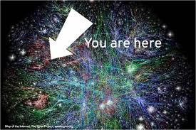
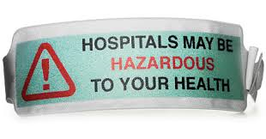
Health Care is Getting More Complex
Notes:
ASK: What changes have you seen in health care in the last 10 years? What changes have you seen at Mercy Medical Center in the last 10 years?

Slide 4
Change vs. Transition
Notes:
Change is connected to events (building a new bed tower, getting a new electronic medical record, mergers, acquisitions, expansions, closing a service line, implementing a new service line, etc.).
Transitions accompany change but they are more than functional shifts, they require psychological reorientation.

Slide 5
Change vs. Transition
External task
Implementation plan
Timetable
Benchmarks/metrics
“Just do it!”
Internal reorientation
No defined road map
Variable time frame
Culture and identity
Motivating hearts
Notes:
William Bridges’ classic book, “Managing Transitions – Making the Most of Change” defines the difference between change and transition and what is the role of leaders during transitions and change. They are not the same both often occur together

Slide 6
Change vs. Transition
Notes:
In change models, the end is the goal and when you have successfully implemented the change you have achieved value.
When you pay attention to transitions that people are going through, you realize there is value that comes in the journey; the process, and not just reaching the destination, or desired outcome is valued.

Slide 7
Three Transitional Elements
Endings
Celebrate what was
Time to grieve
Claim the identity that moves forward
Neutral Zone
Awkward, uncomfortable phase
Cannot be rushed through
Place where hopes and dreams emerge
New Beginnings
Articulated vision
Creativity
Behaving in a new way
Notes:
Endings: As leaders we need to understand asking associates to let go of something that has been successful in the past is asking them to change their sense of “identity” and what they have known as “reality.” Endings take time to grieve and there needs to be a celebration of what had worked and contributed to bringing us to where we are now. It is also a time when we need to ask: “What is still going forward?” Celebrating what is core to identity. Mission, core values, heritage of founders, what we believe needs to be carried forward.
Do not romanticize the past. Remember the past was once the new beginning which itself meant it went through a letting go and neutral phase. (To the Hebrews, it was important that the God who had spoken to him was the God of their fathers Abraham, Isaac and Jacob. On the night of the Passover, the Jewish people continue to remember the past because they believe in re-telling the story, the same saving power of God is present.
Naming and grieving the losses and hurts empowers people to let them go. Moving on without naming, celebrating and grieving minimalizes the past. Rituals are important to this process. This is key to Catholic health care. We want our identity, heritage, culture, mission and values to go forward. (Example of the organization that did not grieve and threw away the mission and core values posters which employees saw).
Neutral Zone (exploration) - It is an awkward, uncomfortable phase that leaders often want to rush ahead and get to the new situation. The neutral time cannot be raced through. It is not wasted time, but a time of grieving and yet creativity. It is where the energy of transformation takes place. Historian Arnold Toynbee calls this the “creative wilderness period” that often precedes the key to revitalization of societies or organizations. (Give examples)
The time in the neutral zone can remind us who we are as an organization no matter if the structures and processes change. Visible reminders of what is core is crucial: statues, heritage walls, stained glass windows, mission and core values displayed and referenced in meetings, decisions and communications. Touch stones that remind us who we are. (Example of Mount Carmel Stained Glass, Grandpa Smith’s violin, family heirlooms)
New Beginnings (moving forward) – Leaders must speak a clear, concise vision that can be understood at all levels of the organization. This is a time of creativity for everyone, not just the leaders and all should be encouraged to have fresh eyes and dream new possibilities. Leaders must remind associates why we are leaving the past and journeying to something new and better. We must be able to articulate the vision clearly and succinctly in language that can be understood by all audiences. We engage associates in the new vision and dialogue with them because many times they have the creativity and ingenuity to know what are the steps to move to the new. This engenders collaboration and energy and change is no longer seen as being pushed from the top down. (President Kennedy Visit to NASA in 1963 – “I’m working to put a man on the moon!”)
Housekeeper - My job is to make sure the patient’s room is clean and germ free so that they heal and don’t get any infections while they are here.
Nutrition Services: My job is to prepare nutritious food for the patients so their bodies will be strong and be able to heal.

Slide 8
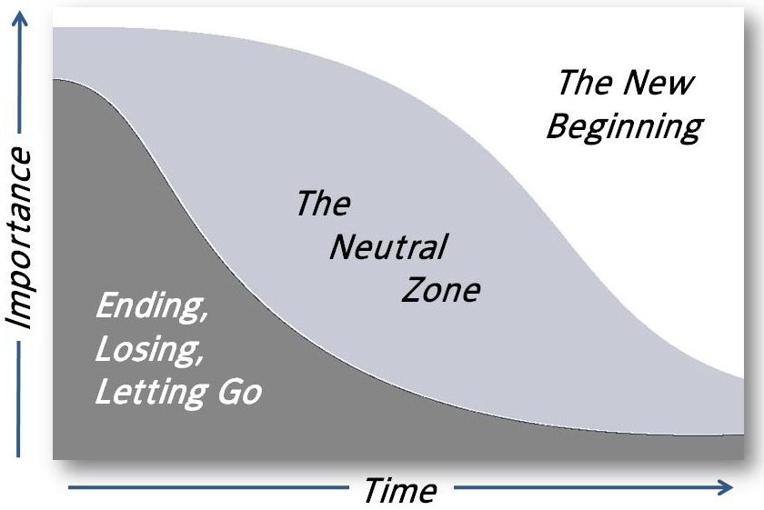
Three Transitional Elements
Notes:
William Bridges’ classic work: Managing Transition’s – Making the Most of Change names three transitional elements
Notice the importance of spending time in the ending and letting go in the early stages and how it tapers off with time. We spend a lot of time in what he calls the “neutral zone” while we are in transition and as we move into the “new beginning” or the new way of doing things.

Slide 9
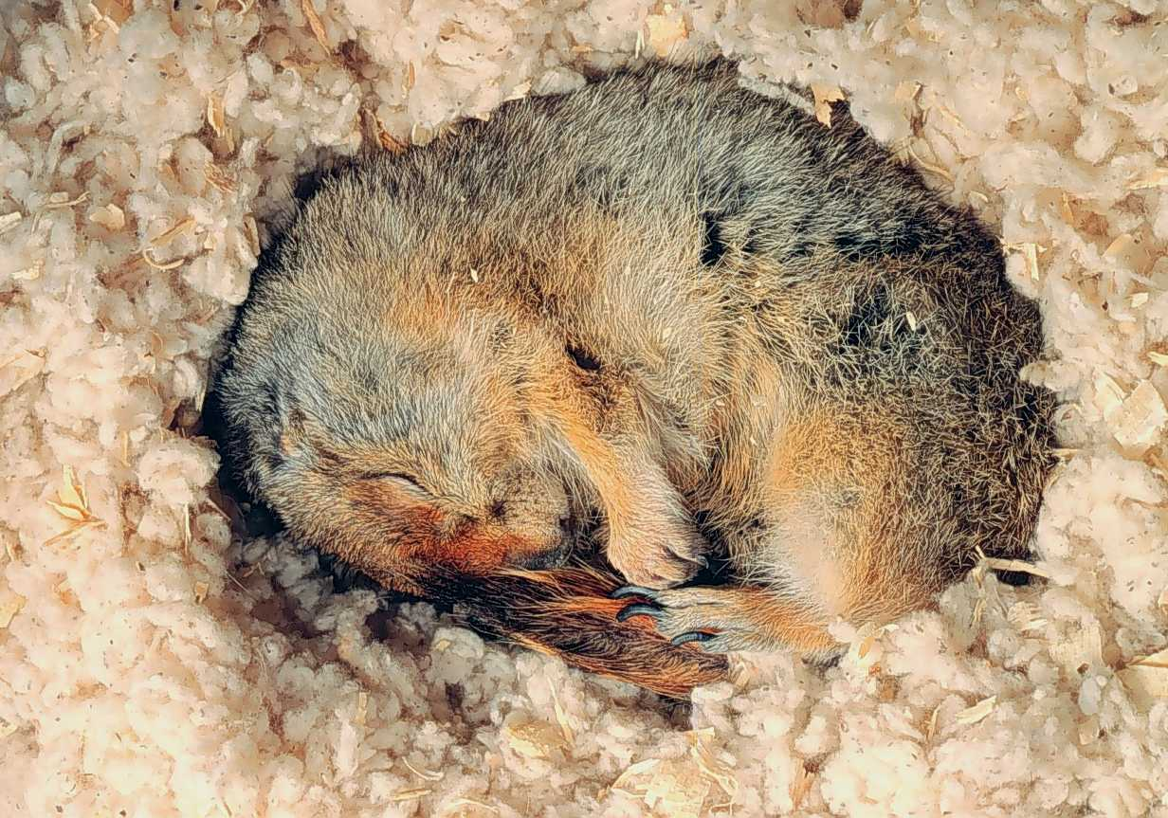
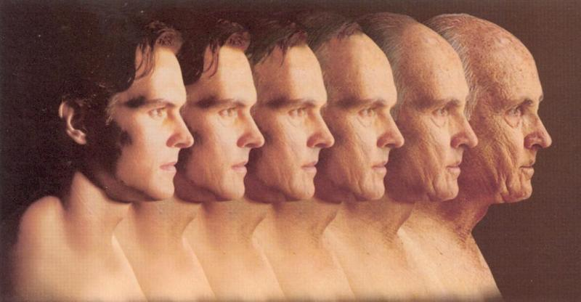
Transition is Part of Life
Notes:
Parallels in nature (fall, winter, spring; hibernation of animals; cycle of the cocoon to butterfly).
Fall – Letting go, leaves die, acorns drop and are buried by those pesky squirrels. Animals hibernate
Winter – Not wasted time. Time of laying fallow, opening the ground to receive the rain and snow and nutrients that will be necessary for crops next year.
Spring and Summer – New beginning and growth which are the results of what happened in the fall and winter.

Slide 10
The Old Man and the Butterfly
Transitions Cannot Be Rushed
Notes:
There was a wonderful old man who loved everything. Animals, spiders, insects ...
One day while walking through the woods, the nice old man found a cocoon. He decided to take the cocoon home to watch its beautiful transformation from a little cocoon to a beautiful butterfly.
He gently placed the cocoon on his kitchen table and watched over it for days.
One day the cocoon started to move. It moved frantically! The old man felt sorry for the little butterfly inside. He watched it struggle and struggle!
Finally the old man rushed to its aid with a scalpel and gently slit the cocoon so the butterfly could emerge.
Just one slice was all it took, and the butterfly broke free from its cocoon only to wilt over in a completely motionless state. The old man did not know what to think. Had he accidentally killed the little butterfly? No, it was still moving a little bit. Maybe it was sick. He was quite perplexed. He decided the best thing he could do for the butterfly was to place it gently back into its cocoon.
He did so, and placed a drop of honey on it to seal the cocoon, leaving the butterfly to nestle in its natural state.
The next day he noticed that the cocoon was moving again. It struggled and struggled. Finally the butterfly broke free from its cocoon and stretched its wings out. Its beautiful wings were filled with wonderful colors! It took off! It was flying! And that wonderful butterfly flew and flew till it was almost out of the old man's sight. What a joy, he exclaimed! But then he started to think. What did I do wrong by trying to help that beautiful little butterfly out at first?
The old man went to the library and read every book he could find on butterflies and cocoons. Finally the answer appeared. The butterfly has to struggle and struggle while inside the cocoon. That's how it gets its strength. That's just what they are designed to overcome in order to be strong and beautiful.

Slide 11
Learning Partner Exercise
Name an example of a time you had to let go without knowing what was on the other side. What did you learn in the awkward “in-between” time? Did the “neutral zone” make you stronger?
What images of nature, life experiences or metaphors have helped you during times of transition?
Notes:
10 minutes for learning partner exercise
5 minutes to hear commonalities in the room.

Slide 12
Getting Through the Wilderness: Exodus as a Story of Transition – Endings
Leaving a place of slavery and bondage
Outdated ways of thinking and doing things
Slaves to past because it’s what “we have always done”
Announce a “change” and plagues will follow
Ritualize our endings
Grieve what is left behind
Celebrate the identity being carried forward
Every organization needs a “Red Sea” moment
No turning back
Notes:
Next few slides are based on William Bridges article: Getting Them Through the Wilderness.
Slavery and Bondage Thinking – Fear of going to an EMR, fear of expanding Medicaid. Not wanting to look at new models of care delivery because we are used to the acute care model and not sure what an ACO or “covered lives” model will look like from a reimbursement stand point. Sometimes we know we need to change, but fear of the unknown makes us dig in our heels and resist change.
Ask: What are the plagues that can undermine an announced “change?’
Defection
Labor unrest
Sabotaging the new
Hardened hearts
How do we pray, reflect, ritualize our endings and passages?
Red Sea Moments – Tearing down a building, turning off an old software system, consolidating a service line into one campus where is may have once been on two campuses.
Spanish explorer Cortes ordered the ships to be burned when they reached the shores of Mexico. Clear message: There is no going back, only forward. It is natural for people to want to go back to the old and familiar. The Red Sea event sends the clear message the past will no longer enslave you, but you also cannot go back.

Slide 13
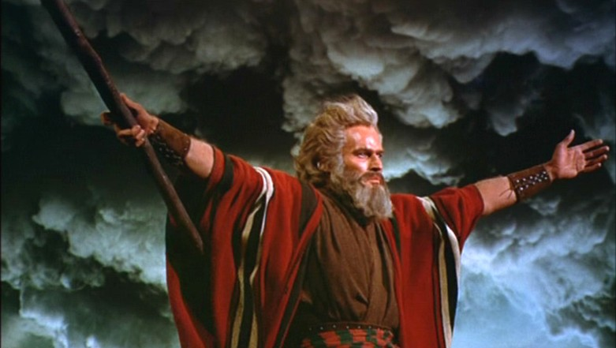
Where do you need a Red Sea moment?
Table Exercise
Write down something in your life or work experience you need to let go or leave behind.
Is anything keeping you in “bondage” or stopping you from making progress?
Notes:
Table Exercise: Write on one of the pieces of special paper at your table something you either personally need to let go of, or something your team, department, or Mercy Medical Center needs to let go of? Where do we need to say, “There is no turning back, I must move forward?”
Dissolving Word Exercise (No words, let the gesture and music speak to the heart)
BREAK

Slide 14
Table Exercise
Notes:
Invite people to take a piece of bread and offer to the person next to them with a blessing. It might be as simple as:
May God be with you on your journey
May the Lord give you your daily bread
May you always have what you need for life’s journey.

Slide 16
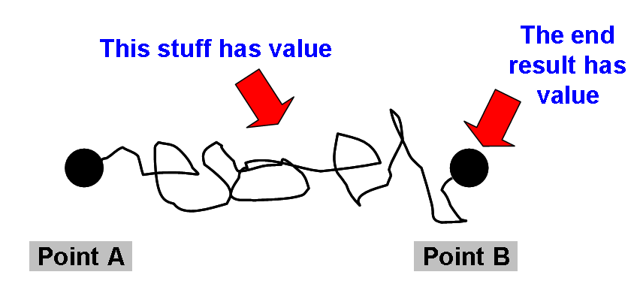
Neutral Zone – The Importance of the Wilderness Period
Unknown and unfamiliar may create anxiety and stress
This takes time
Keep people going
Lift up each other’s spirits
Have a miracle or two up your sleeve
Notes:
Acknowledge with change comes, stress, anxiety and angst!
Change and transitions take time, and to pretend we can set a deadline and achieve it without paying attention to people and their needs is naïve.
Alan Bowman says: “The process is the most important part of change management.” If you are a leader, keep the spirits of the staff going. If you are members of a team, lift one another up.
Miracles of the manna, quail and water from rock. What are the ways we celebrate the short-term successes along the way to build up spirit and confidence that we are on the right path? How do we take time to celebrate God is with us on the journey.
The Story of the Road to Emmaus illustrates how this neutral zone can move from fear and chaos to grumbling to questioning to community and hope and transformation..

Slide 17
Self Care in the Wilderness
How do we care for our soul in the wilderness?
Take time to speak with God daily
Does your face show your connection to God?
Bring problems and questions to discernment
God still feeds us in the wilderness
How is God sustaining you?
Do you give thanks for your daily bread?
We are part of a ministry bigger than any one of us
God will not abandon us
Where is the pillar of fire guiding us?

Slide 18
Role of Leaders in the Wilderness
Walk among the people – be visible
Listen to their grumbling
Opportunity for bonding and community
Notes:
Moses and Aaron and those they designated walked among the people and kept the vision alive, answered their questions, let them continue their grieving and complain.
It is from this engagement that the people begin to envision the Promised Land for themselves. From their grumblings and questioning emerges energy and ideas for the future. They become
part of the solution moving forward.
The time in the wilderness, the neutral zone, is not wasted time, it is a time when the Hebrews form community and begin to take responsibility for one another. Do we use transition times in our organization as a possibility for growing closer to our associates and to one another in our work teams. Do we try to survive it alone or do we pull together as a team?

Slide 19
Identity and Community
What must we preserve to keep our identity?
What is in our Ark of the Covenant?
How does the wilderness time bring us closer together as a community of healers?
Do we allow the time necessary to reflect on the deeper meaning of what is going on in the midst of change and transition?
Notes:
Be thinking: What is in our Ark of the Covenant? What is sacred to Mercy Medical Center that must be preserved and carried forth through any change and transition? We will come back to this in a little bit. Catholic identity, heritage, desired culture
Moonstruck:
Olivia Dukakis – Rose
John Mahoney – College Professor dumped by a younger student
They dine together, he walks her home, expects he will be invited in and then is surprised that he is not. When he asks Rose why:
Because I know who I am.
Do we know who we are as an organization and how we will preserve that identity even in uncertain times?

Slide 20
Learning Partner Exercise
Where have you seen a co-worker taking care of another co-worker’s spirit?
Where do you experience community and teamwork at Mercy Medical Center?
Notes:
5 minutes depending on time.

Slide 21
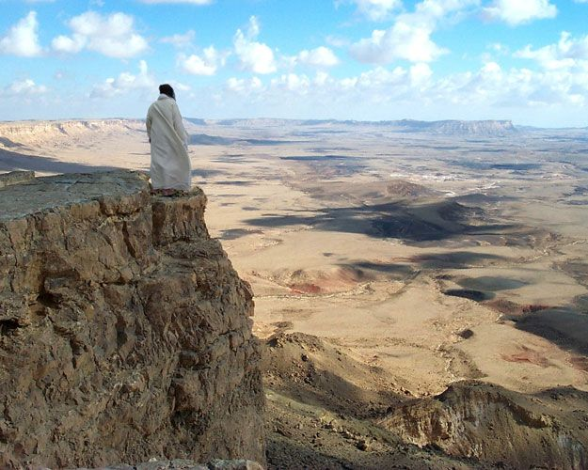
New Beginnings – The Promised Land
Leaders communicate the vision
From grumbling, to questioning, to hope
Associates are part of crafting the “new”
Principle of subsidiarity
Collect wisdom from this journey for the next time
History shows change and transition is ongoing
Notes:
From the grumbling, questioning, listening, reflecting, sharing meals, recalling who we are and what is our core identity … emerges our dreams and hopes for the future. We use this energy form the associates to craft the new, to help shape the future. This is the Principle of Subsidiarity. Involving the associates in the change instills community and working towards a new vision together and not one that is imposed from on high. (Example of the ER nurses thinking of ways to cut $250,000 a year without anyone losing their job)
In the story of Exodus continued in the Book of Joshua, we have another “no turning back point” when the Hebrews cross the Jordan River reminiscent of their crossing of the Red Sea. The Hebrews seize their “Promised Land” together as a community, as the horns sound and the walls of Jericho come down and the people take over the town. They do this together. It is not one person Moses, or Joshua claiming the new beginning, it is a community.

Slide 22
Jesus Follows the Same Pattern
Philippians 2:6-11
Paschal Mystery
Cross – Ending
3 days – Wilderness
Resurrection – New Beginning
Christians enter this mystery through baptism
Notes:
Jesus who, being in very nature God, did not consider equality with God something to be grasped, 7but made himself nothing, taking the very nature of a servant, being made in human likeness. 8And being found in appearance as a man, he humbled himself and became obedient to death-- even death on a cross! 9 Therefore God exalted him to the highest place and gave him the name that is above every name, 10 that at the name of Jesus every knee should bow, in heaven and on earth and under the earth, 11 and every tongue confess that Jesus Christ is Lord, to the glory of God the Father.

Slide 23
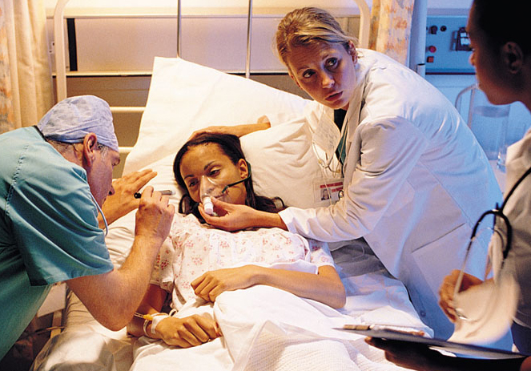
Human Suffering Follows This Pattern
Endings: Sickness, disease, loss of independence, wholeness
Neutral Zone: Tests, consults, diagnosis, treatment
New Beginnings: Cure; finding meaning while living with chronic illness or a terminal disease; reconciliation with self, families and God; death with dignity
Notes:
We in Catholic health care experience people in the midst of transition all of the time. An awareness of these stages of transition and that there is a psychological, emotional and spiritual component to them is a gift we can bring to our patients. We are not the only ones going through transitions. Our patients and their loved ones are as well.

Slide 24
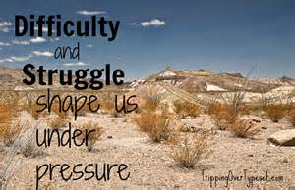
The Wilderness Can Transform Us
“All change results from a change of meaning. Change occurs only
when we let go of our certainty, our current views, and develop a
new understanding of what’s going on.” Margaret Wheatley
Notes:
We have all been through these moments of wilderness which we hate when we are in the midst of them, but realize when we emerge from them that growth has taken place. Growth that could not have happened any other way. Give examples.

Slide 25
Table Exercise
How do we make sure we are paying attention to the transitions in the midst of the rapid changes occurring in health care?
What are the mission, values, culture and Catholic identity questions we need to be asking?
What are the non-negotiable “must have’s” for our organization going forward? What is our Ark of the Covenant?
Notes:
10 minutes
Conclusion: Conclusion: The essence of Catholic health ministry is found in its care for individuals and families who are ill and in need of healing. This is based on the healing ministry of Jesus. In that ministry, Jesus connected his followers to the past, helped them to see, name and deal with their present struggles and chaos and allow them to discover the new meaning which was emerging from their grief and sorrow of having watched him be crucified. Our Judeo Christian story of the Exodus and Paschal Mystery give examples of how we can move through periods of letting go, into periods of unknown wilderness, where eventually we find the new life emerging. This is not because of our human intellect or our science and technology. It is because of our God’s faithfulness to His promise that he will journey with us.

Slide 26
Closing Reflection and Commissioning
Notes:
Closing ritual with symbolic gift given to participants.
Prayer of Sending

