Slide 1
CHA Sample Orientation
For Medical Mission Trips
Created by:
Bruce Compton
Senior Director, International Outreach
Catholic Health Association of the United States
Notes:
This is a sample PowerPoint presentation for your use as an educational tool to help you develop an orientation process for participants on your medical mission trips. It is designed for you to customize to suit the needs of your program—adding or deleting slides where you deem appropriate.
CHA has attempted to provide instructions, explanations and examples to help your orientation process be as smooth as possible. Please consider this a work in progress. Therefore, when developing your medical mission program, if you find that pertinent information has been omitted by CHA, please do not hesitate to let us know so that we can update this sample orientation, which will be housed on CHA’s website at www.chausa.org/international.

Slide 2
Table of Contents
Opening Reflection and Prayer Slide 3
Our Call to Send Medical Teams (Video) Slide 6
Introduction to Our Partnership Slide 7
Called To Serve: Guided by Tradition (Video) Slide 8
Guiding Principles Slide 11
Modern Day Parable (Video) Slide 19
Typical Hospital Scenario (Video) Slide 22
Our Passports and Plane Tickets – Logistics Slide 23
CHA Recommendations for Practice Slide 29
Unite for Sight’s Training Program Courses Slide 32
Resources On: Customs, Culture and Etiquette Slide 34
The Heart Which Sees: On Being Neighbor (Video) Slide 35
Closing Remarks Slide 36

Slide 3
Opening Reflection and Prayer
Reader 1
"Then the LORD asked Cain, 'Where is your brother Abel?' He answered, 'I do not know. Am I my brother's keeper?" The LORD then said: 'What have you done? Your brother's blood cries out to me from the soil!' "
— Genesis 4:9-10
Reader 2
"Cain's question, 'Am I my brother's keeper?', has global implications and is a special challenge for our time, touching not one brother but all our sisters and brothers. Are we responsible for the fate of the world's poor? Do we have duties to suffering people in far-off places? Must we respond to the needs of suffering refugees in distant nations? Are we keepers of the creation for future generations? For the followers of Jesus, the answer is yes."
— U.S. Bishops, Called to Global Solidarity
Notes:
Identify two readers to read these quotes.
Print and hand to them in advance so they have it easily available and won’t have to read it from the screen.

Slide 4
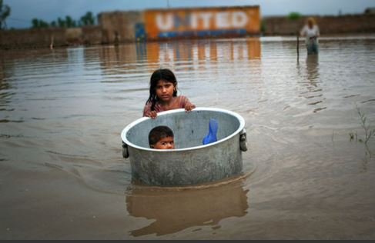
Opening Reflection and Prayer
Notes:
Leader
We gather here today to reflect on our call to global solidarity. The nature of this call is a challenging one. When we cannot seem to adequately address all the problems of even our own neighborhoods, how can we begin to take responsibility for the immense problems that face the world at large? And yet, when we see the face of a dying infant in Cameroon; a mother without AIDS medication in Kenya; or the disfigurement of a war survivor in Iraq, a voice deep within lets us know that these persons, too, are our brothers and sisters and their "blood" — their suffering — cries out to God.
I invite you to pause for a moment in silence and call to mind the faces of suffering persons from around the world that have touched you in your life — perhaps persons that you have met through travel or study, perhaps faces known only through watching the news or reading. I invite you to hold these persons in prayer as you might hold a brother or a sister in need.
Pause for silence (Count to 20)
Now ask participants to: Take a moment to reflect on the photo. (Pause for 30 seconds)
Ask participants what they see in the photo or how it makes them feel.
Things you might mention to get started or to fill in when quiet in room:
The word United in the background on the building –
The person in the background, what are they doing? Who is it? Does this person need help?
Who took the picture? Was this person helping? What was this person’s role?
Do the children really need help? Are they just playing?
It is hard to know the answers to these questions based on the picture. Often what we see at first glance in the developing world is similar.

Slide 5
Opening Reflection and Prayer
Prayer
Loving God,
You are the God who is not silent in the face of suffering. You are the God who hears the cries of those oppressed by violence, pain and poverty. And, you open our ears to this cry as well.
As we come before you this day, stretch our hearts to embrace with compassion not only those persons that we have now called to mind, but also, all the persons of this earth.
Make our hearts as wide as the world, as fathomless as your own heart. And when we hear the plea of our sisters and brothers in far away places, show us how you would have us say ‘yes’.
In your name we pray, Amen.
Notes:
If you do not intend for your audience to read from the screen, print and hand out in advance (or place copies on each table) so they have it easily available.

Slide 6
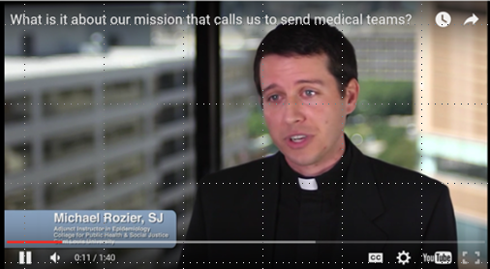

What is it about our mission that calls us to send medical teams?
iframe width="640" height="350" src="https://www.youtube.com/embed/3aX3lVBn4T0" frameborder="0" allowfullscreen></iframe>
<
Watch the Video
Notes:
The link to this video can be found on YouTube:
https://www.youtube.com/watch?v=3aX3lVBn4T0
If the link is broken on this slide, please copy and paste the following link when inserting a Hyperlink to the video in your presentation:
https://www.chausa.org/international-outreach-video-scenarios/video-scenario---conducting-mission-and-immersion-trips/what-is-it-about-our-mission-that-calls-us-to-send-medical-teams

Slide 7
Introduction to (YOUR PARTNERSHIP)
  Who is the partnership with?
  When did the partnership start?
  Where is/are our partner(s) located?
  What are the objectives of the partnership?
  What are the objectives of our trip?
  Why is this partnership important?
      For us, the U.S. partner
      For our International partner
  How does our partnership relate to our ongoing ministry?
Notes:
Review your organizational partnership at a high level and make sure all of the following questions are addressed:
Who the partnership is with
When it started
Where it is located
What are the objectives of your trip
Why it is important for all involved – both the U.S. and the International partner
How it relates to the ongoing ministry
This may take several additional slides that you may want to provide to ensure that all objectives and the importance of this partnership are clearly expressed to your participants.

Slide 8
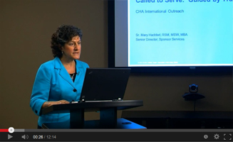
Called To Serve: Guided By Tradition
Called to Serve: Guided by Tradition
By: Sr. Mary Haddad, RSM, MSW, MBA
CHA Vide President, Mission Services
What: Leads viewers through a discernment of the "call" to participate in the ministry of Catholic health care and, specifically, international outreach.
Length: Approx. 12 minutes.
For: Boards, sponsors, executive teams, staff who have or could participate in international missions/ immersion as well as orientation for staff members.
» Watch The Video
» Download Facilitation Guide
Notes:
Called to Serve: Guided by Tradition
Presented by
Sr. Mary Haddad, RSM, MSW, MBA
CHA Vice President, Mission Services
Suggestions for Theological Reflection and Formation Study
The following process is offered as an outline for discussion of the video “Called to Serve: Guided by Tradition.” It provides suggestions for reflection and discussion on the challenges of international outreach. It is designed to be adapted to the needs of small or large groups such as boards, sponsors, executive leaders and formation groups, but is also relevant for all associates—especially those who are interested or have participated in international outreach. Too, it will be useful in orientation.
Provide the group with “A Shared Statement of Identity For the Catholic Health Association.” Ask someone to read aloud the second paragraph of the statement, beginning with, “We work to bring alive … “ Invite responses to the following question:
Think of a personal experience you have had in promoting health and delivering health care with “special attention to our neighbors who are poor, underserved, and most vulnerable.” Did that experience help to bring about change for others? Did the experience bring about change in you? (Perhaps ask them if so, how?)
2. Show the video (approximately 12 minutes). Read this lead-in to the video:
In this video titled “Called to Serve: Guided by Tradition,” Sr. Mary Haddad, vice president of mission services at the Catholic Health Association, speaks about the theological and historical roots of international outreach by Catholic health care ministries. She provides a bit of guidance on ensuring cultural competence and how to serve as a partners in this work. As you watch and listen, consider how our tradition of service naturally leads to international outreach.
After the video, ask the group to think about and discuss the questions that are raised at the end. If it is a large group, you may assign the questions to different tables for discussion.
What of our tradition most resonates with your call to serve those on the margin of society?
How are you being called to advance the work of caring for those beyond our borders?
4. The following question is provided as an option for further discussion:
How can we assure that dignity, respect and mutual cooperation are built into our international outreach efforts?
A Shared Statement of Identity for the Catholic Health Ministry
We are the people of Catholic health care, a ministry
of the church continuing Jesus’ mission of love and
healing today. As provider, employer, advocate,
citizen—bringing together people of diverse faiths and backgrounds—
our ministry is an enduring sign of health care
rooted in our belief that every person is a treasure, every life a
sacred gift, every human being a unity of body, mind, and spirit.
We work to bring alive the Gospel vision of justice and peace.
We answer God’s call to foster healing, act with compassion,
and promote wellness for all persons and communities, with
special attention to our neighbors who are poor, underserved,
and most vulnerable. By our service, we strive to transform
hurt into hope.
As the church’s ministry of health care, we commit to:
• Promote and Defend Human Dignity
• Attend to the Whole Person
• Care for Poor and Vulnerable Persons
• Promote the Common Good
• Act on Behalf of Justice
• Steward Resources
• Act in Communion with the Church

Slide 9

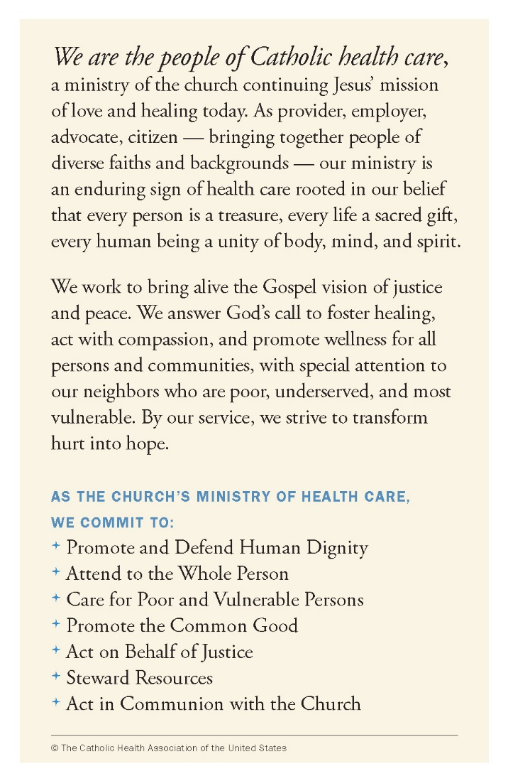
A Shared Statement of Identity
Notes:
PLEASE NOTE: Pocket Cards in packs of 50 can be purchased from the CHA Store for the member price of $4.00 per pack. Cards are available in English, Spanish, and Hindi.
Pocket Cards can be ordered from the following CHA site: https://www.chausa.org/store/products/product?id=2842

Slide 10

Guiding Principles
Order a copy of the Guiding Principles
Download a PDF of the booklet
Notes:
All resources including videos and facilitator guides can be found at: https://www.chausa.org/internationaloutreach/guiding-principles
Background
Compelled to continue Jesus’ mission of love and healing today, U.S.-based Catholic health care organizations are reaching out to our brothers and sisters around the world to improve their health status and quality of life. This tradition of international ministry is a testament to the commitment of associates from across Catholic health ministry to live up to the Gospel mandate to provide compassionate care, with special attention to those most in need.
CHA and its members have named six Guiding Principles for Conducting International Health Activities. These principles bring to life the richness of Catholic social teaching and tradition. Based loosely on the “Oath for Compassionate Service” in the book Toxic Charity by Robert Lupton, and insights from a special workgroup CHA convened to examine current international health program practice in light of our ministry’s commitments, they are offered to help Catholic health care most appropriately conduct international programs.
[REMEMBER TO CREATE A HYPERLINK AND INCLUDE THE ELECTRONIC DOWNLOAD VERSION ON THIS SLIDE: Copy and paste the link below into the address section of the hyperlink screen]
https://www.chausa.org/guiding-principles
These six Guiding Principles are:
Prudence (Don’t just do it)
Authenticity (Know thyself, know thy partner)
Honesty (Trust is earned and learned)
Patience (Build capacity, not dependency)
Excellence (Best intentions do not equal best practices)
Humility (We all have something to learn)

Slide 11
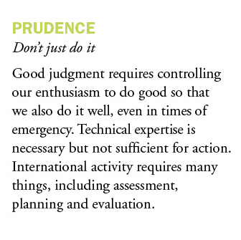

Guiding Principles
Notes:
Too often when we don’t exercise prudence, the enthusiasm to do good can create more harm than good. According to Robert Lupton in the book Toxic Charity, “We mean well, our motives are good, but we have neglected to conduct careful due diligence to determine emotional, economic and cultural outcomes on the receiving end of our charity. Why do we miss this crucial aspect in evaluating our charitable work? Because, as compassionate people, we have been evaluating our charity by the rewards we receive through service, rather than the benefits received by the served. We have failed to adequately calculate the effects of our service on the lives of those reduced to objects of our pity and patronage.”
An Excerpt from: A Shared Statement of Identity for the Catholic Health Ministry
“ … our ministry is an enduring sign of health care rooted in our belief that every person is a treasure, every life a sacred gift, every human being a unity of body, mind, and spirit.“
With that in mind, we must ensure that when conducting international outreach we act with prudence and appropriate respect.
Compelled to continue Jesus’ mission of love and healing today, U.S.-based Catholic health care organizations are reaching out to our brothers and sisters around the world to improve their health status and quality of life. This tradition of international ministry is a testament to the commitment of associates from across Catholic health ministry to live up to the Gospel mandate to provide compassionate care, with special attention to those most in need.
Act with Prudence in planning, implementing and evaluating international health activities.

Slide 12
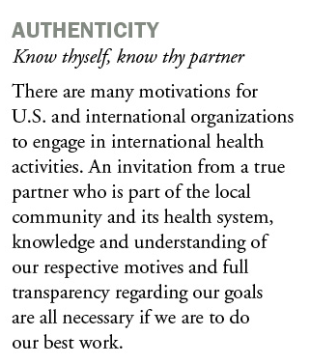

Guiding Principles
Notes:
I’m relying heavily here on quotes from the book Toxic Charity by Robert Lupton:
“The best service projects are joint ventures where the need is real and the vision compelling, the work is organized and productive, and the interests of both groups are satisfied.” pg. 186
Here are a few suggestions that can help make this happen:
Planning meeting
Reaching agreement
Schedule
Last-minute check-in
Launch
Fellowship
Meaning
An Excerpt from: A Shared Statement of Identity for the Catholic Health Ministry
“We answer God’s call to foster healing, act with compassion, and promote wellness for all persons and communities, with special attention to our neighbors who are poor, underserved, and most vulnerable.“
This principle reminds us that we must work with a local partner, understand everyone's motives and be transparent regarding our goals if we are going to do our best work.
Maintain Authenticity by identifying the true motivations of all stakeholders.

Slide 13
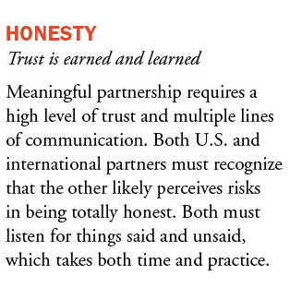

Guiding Principles
Notes:
Another Example from Toxic Charity:
“Expenditures for a week of service by church and college groups are grossly out of proportion with what is actually accomplished. U.S. mission teams who rushed to Honduras to help rebuild homes destroyed by Hurricane Mitch spent on average $30,000 per home – homes locals could have built for $3,000 each.”
In our Shared Statement, “We work to bring alive the Gospel vision of justice and peace.”
It is important to recognize in this example how hard it might be to be honest when you have great needs. Think about the implications.
We feel good, but we possibly keep someone with local skills from making money. We spend 10 times more than it would have cost locally. Being honest with our partners, asking them to be honest with us, and creating the space for this type of communication is extremely important to our long-term success. Otherwise, whenever we leave, they will tell the truth to someone and we might look bad! Being honest and nurturing a relationship of trust will help us be better stewards of our resources.
Ensure Honesty in all communications to build meaningful and lasting partnership;

Slide 14
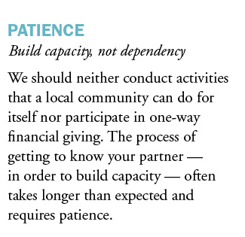

Guiding Principles
Notes:
And yet another Example from Toxic Charity:
Compassionate people desire to see action on behalf of struggling communities.
“Little affirms human dignity more than honest work. One of the surest ways to destroy self-worth is subsidizing the idleness of able-bodied people. Work is a gift, a calling, a human responsibility.” Toxic Charity pg. 152.
From A Shared Statement for Catholic Identity: “By our service, we strive to transform hurt into hope.”
Being patient as we work toward building capacity could be the way we do just that. Honestly evaluating the benefits and limitations of our interventions can help us understand the difference between addressing “lifestyle” poverty that may create dependency, and building capacity for the long term that addresses the true needs of the community. By building capacity we do transform hurt into hope!
Practice Patience in getting to know all partners’ assets and true needs, including our own.

Slide 15
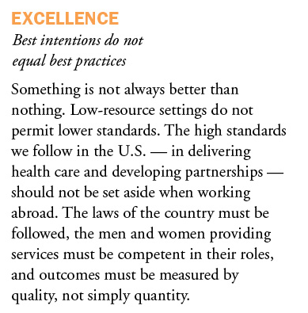

Guiding Principles
Notes:
Consider this, as reported by Dambisa Moyo in Dead Aid, a World Bank study found that 85 percent of the aid money flowing into African countries never reaches the targeted areas of need and often goes to unproductive (if not blatantly corrupt) uses.
Promote Excellence by demanding high standards that result in quality service delivery.

Slide 16

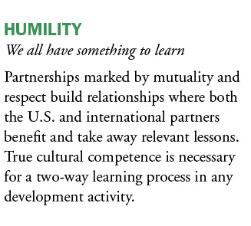
Guiding Principles
Notes:
Betterment programs of many service organizations and ministries may actually work at cross-purposes with goals to develop people. Transition from betterment to development is necessary.
Inspire Humility by encouraging mutuality and respect in all interactions.

Slide 17

Toxic Charity by Robert Lupton
The Oath for Compassionate Service
Notes & Review
Key Quotes
Available Formats
Notes:
CLICK ON THE BULLETED TITLES TO LINK TO THE BELOW-MENTIONED WEBSITES
The following websites provide book reviews of Toxic Charity and a link to purchase from amazon.com which you may or may not want to use in your presentation. These are provided merely as a means of information for you in case you have not read or know of this book.
The following website provides a book review by Catholic Charities of the Diocese of Toledo:
https://catholiccharitiesnwo.org/the-oath-for-compassionate-service-2/
The following website provides Notes and Review by WordPress.com:
https://vialogue.wordpress.com/2012/12/22/toxic-charity-notes-review/
The following website provides a direct link to amazon.com for purchasing as Kindle, Hardcover, Paperback or Audible:
http://www.amazon.com/Toxic-Charity-Churches-Charities-Reverse/dp/0062076213
The following website provides a link to 15MinuteBusinessBook.com which provides a handout that includes a synopsis and key quotes from “Toxic Charity”:
https://www.inphilanthropy.org/sites/default/files/files/pages/Toxic%20Charity%20Synopsis.pdf

Slide 18

Dead Aid by Dambisa Moyo
Book Synopsis
Order Info
Video
Notes:
CLICK ON THE BOOK “DEAD AID” TO GO TO THE WEBSITE
Since mention of this book was made on Slide #15—Guiding Principle on Excellence—you may find the information presented on this slide to be useful for your participants and you may want to incorporate it into your presentation. By clicking on the actual book copied onto this slide, it will take you to the link shown below, which is Ms. Moyo’s website. There you will find a brief synopsis of her book and in the top right-hand corner, there is an “Order Dead Aid” button that will give various amazon.com links to several countries for purchase in Kindle, Hardcover and Paperback formats. At the bottom of the webpage, you will find a video interview of Dambisa Moyo on her vision for Africa and what’s wrong with aid.
Consider this, as reported by Dambisa Moyo in Dead Aid, a World Bank study found that 85 percent of the aid money flowing into African countries never reaches the targeted areas of need and often goes to unproductive (if not blatantly corrupt) uses.
Promote Excellence by demanding high standards that result in quality service delivery.
If the link is broken on this slide, please copy and paste the following link when inserting a Hyperlink to this webpage in your presentation:
http://dambisamoyo.com/publications-articles-videos/books/dead-aid/

Slide 19
Guiding Principles
Watch the Video
Notes:
Jesus taught through stories.
This animated video of the Modern Day Parable will help individuals and groups consider the opportunities and challenges of international projects. Part of a suite of materials for the Guiding Principles for Conducting International Health Activities, the video is just under four minutes in length and makes for a compelling reflection exercise and catalyst for a discussion of the issues to consider when planning health and mission activities in low-income countries. In it, Fr. Michael Rozier, SJ, who authored the parable, narrates. Its companion pieces include the Guiding Principles booklet and the Facilitation Guide for the Guiding Principle.
[NEED TO INCLUDE THE FACILITATOR’S GUIDE ON THIS SLIDE]
https://www.chausa.org/internationaloutreach/guiding-principles/a-modern-day-parable

Slide 20






Guiding Principles
Questions to Consider

Slide 21


Order a copy of the Guiding Principles
Download a PDF of the booklet
Notes:
All resources including videos and facilitator guides can be found at: https://www.chausa.org/internationaloutreach/guiding-principles
Background
Compelled to continue Jesus’ mission of love and healing today, U.S.-based Catholic health care organizations are reaching out to our brothers and sisters around the world to improve their health status and quality of life. This tradition of international ministry is a testament to the commitment of associates from across Catholic health ministry to live up to the Gospel mandate to provide compassionate care, with special attention to those most in need.
CHA and its members have named six Guiding Principles for Conducting International Health Activities. These principles bring to life the richness of Catholic social teaching and tradition. Based loosely on the “Oath for Compassionate Service” in the book Toxic Charity by Robert Lupton, and insights from a special workgroup CHA convened to examine current international health program practice in light of our ministry’s commitments, they are offered to help Catholic health care most appropriately conduct international programs.
These six Guiding Principles are:
Prudence (Don’t just do it)
Authenticity (Know thyself, know thy partner)
Honesty (Trust is earned and learned)
Patience (Build capacity, not dependency)
Excellence (Best intentions do not equal best practices)
Humility (We all have something to learn)

Slide 22
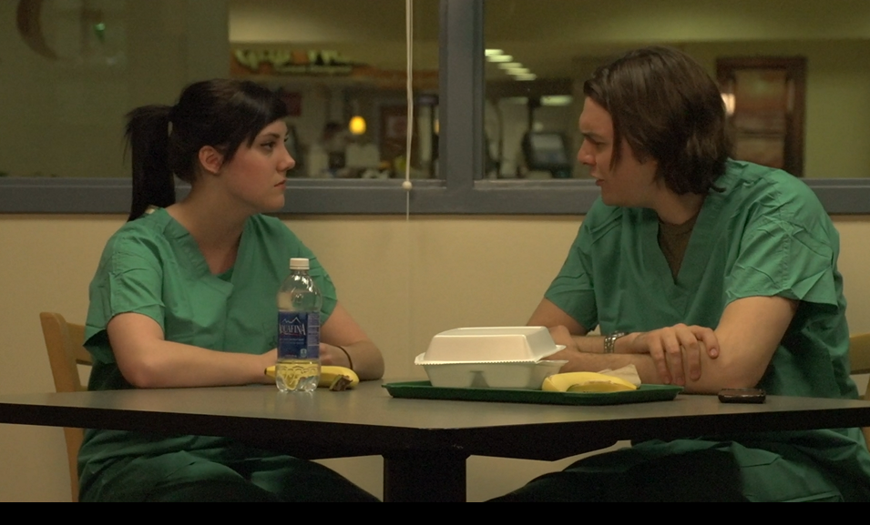
Watch the following 2 videos
Hospital Scenario Video
Conducting mission and immersion trips
Q & A Commentary Videos
Why do we send medical teams? Is it for our benefit or the benefit of those whom we serve?
Watch the Video
Watch the Video
Notes:
Videos linked to YouTube.
#2 Scenario Video Conducting mission and immersion trips (57 seconds)
Q & A Commentary Videos
#3 Why do we send medical teams? Is it for our benefit or the benefit of those whom we serve? (2 min 7 sec)

Slide 23
Passports & Plane Tickets Info
  What are the costs? Create your custom list
    One time (passports, visas, plane tickets)
    Pre-departure (airfare, lodging, project related expenses)
    Travel Insurance
    Out-of-pocket travel expenses (meals at airport, tips, souvenirs, misc.)
    Miscellaneous In-country expenses (currency conversion, entry/exit fees)
Notes:
You may find it more beneficial to distribute this section (Slides 23 thru 27) to your participants as a handout.

Slide 24
Travel Info: Advanced Planning
  What do I need to do in advance? Create your custom list – examples might include:
    Application Deadlines
    Passports, Visas Required
    Flight Arrangements
    Medical Information/Immunizations (CDC and Travel.Gov are always good resources)
    Advance Payment Schedule
    Liability Waivers

Slide 25
Travel Info: 7 Helpful Tips
  Prepare a well-planned itinerary
  Seek information on the culture
  Learn protocol and etiquette practices
  Learn the native tongue
  Check travel advisories
  Protect yourself
  Plan to stay connected
Notes:
The following tips are from an article by Carolyn M. Brown and can be found on the website: http://www.inc.com/guides/201103/7-tips-for-foreign-business-travel.html
PREPARE A WELL-PLANNED ITINERARY:
Reflect what you hope to accomplish
Confirm appointments well in advance and space them comfortably throughout the day
Have a flexible schedule to allow for unexpected problems, such as travel delays and unplanned invitations (luncheons, tours, etc.)
Provide a copy of your itinerary with colleagues, family or close friends so they know where you are supposed to be at all times
Provide a family member or spouse with copies of your passport, medical insurance card, and other pertinent information
Leave an emergency contact list with your travel planner
SEEK INFORMATION ON THE CULTURE:
Learn the history, culture and customs of the country you will visit
Attend cross-cultural seminars or training
Read books about that country
Familiarize yourself on the differences in attitudes of punctuality
Proper use of names and titles – understand the importance of rank
LEARN PROTOCOL AND ETIQUETTE PRACTICES:
Study the general protocol and etiquette of the country
Understanding in advance how to greet counterparts and manage appointments will be very helpful
Account for foreign holidays, business manners, religious customs, dietary practices, humor and acceptable dress
LEARN THE NATIVE TONGUE:
Business associates will appreciate any sincere attempt
Colleges or universities in your area may offer immersion programs
Software programs – Rosetta Stone
Beware of subtle difference in the same language (common English words could have different meanings outside the U.S.)
CHECK TRAVEL ADVISORIES:
Governments issue advisories about safety concerns affecting travel to a particular country or region
Have a backup plan
Find out if a U.S. embassy or consulate is located in the country you travel to and make sure it is fully staffed and functioning
Be aware of what the embassy can or cannot do
PROTECT YOURSELF:
Get travel insurance and find out what exclusions apply
Check with you health plan provider to see if you need to get another policy to cover medical costs for an injury or sudden illness abroad
PLAN TO STAY CONNECTED:
Pack a plug/adapter to charge your electronic devices
Before you leave home, inquire about international options with your cell phone provider
Use Skype on your laptop or a Skype iPhone app to make international calls
Replace your SIM card with one from local (foreign) operators or one designed specifically for international roaming
Make sure you have texting capability, which is more reliable than voice communication

Slide 26
Travel Info: Packing Tips
  What do I need to bring? Packing Tips Create your custom list
    Sample Checklist of items to pack (passports, money, medications, clothing, toiletries, sun protection, shoes, flashlights)
    Sample List of items not to bring (valuable electronics, electrical devices such as hair dryers, curling irons, and shavers)

Slide 27
Travel Info: More Helpful Tips
  Dress code Create your custom list
  Day of travel information Create your custom list
    Where will you meet?
    What happens if? (plane is canceled, someone misses the flight, etc.) Create your custom list
  Arrival information Create your custom list
  Schedule for a typical day Create your custom list
Notes:
These next few slides will help participants to create a “check list” to prepare for a comfortable, productive and safe medical mission experience.
Some important informational tips you may want to emphasize are listed below:
DRESS CODE:
Be aware of the climate season of the country during your trip
Consider durable, quick drying fabrics
Consider when you want to stand out as a foreigner and when you want to blend in
Mission Uniform (identifiable shirt to stand out as a group) – This is a decision for your System Leader Executive
Dress in layers for comfort
Comfortable walking shoes (closed toe, broken in, and able to get dirty)
Shower shoes
DAY OF TRAVEL INFORMATION:
Know when and where you should meet your group
Have a backup plan

Slide 28
Our Passports & Plane Tickets Info
  Security Issues Create your custom list
    Contact information
    Travel insurance information
    In-country travel
    Local movements (where are we allowed to go, when, and with what permissions)
  Communications
    Will people be able to communicate with the U.S.? How?

Slide 29
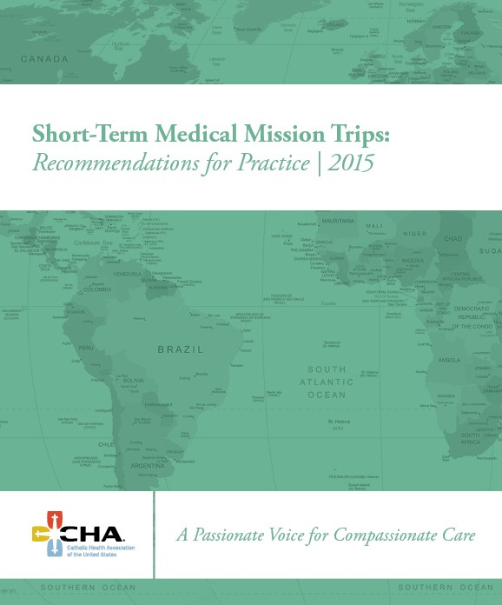
CHA Recommendations for Practice
Order a copy of the book
Download an electronic copy
Order the webinar recording
Notes:
Over the past two decades, the number of short-term international mission trips for the provision of health services has dramatically increased. Catholic health care has participated in this growth. According to researchers at Harvard Medical School, an estimated 6,000 medical missions are sent from the United States to low- or middle-income countries every year with an annual expenditure of at least $250 million dollars.
While these experiences provide an opportunity for Catholic health care to continue its mission of reaching out to those persons who are poor, sick and vulnerable, there are consistent concerns about their value and effectiveness. Considering the significant human and economic investment in health service trips, it is essential to gain a better understanding of these activities and to consider how they can provide the maximum benefit for all involved.
About This Guide
This guide provides data, guidance and commentary. While not prescriptive in nature, the Recommendations for Practice and the accompanying questions for reflection should lead a process of assessing any current international activities as well as those that arise in future.
As you will see, there are distinct opportunities for CHA members associated with responsible international outreach to:
Strengthen the mission of Catholic health care globally.
Be a leader for the broader international development community and in the world of global health.
Build support from the CHA donor community.
Establish the cultural awareness and relevance to better serve patients at home.
Strengthen the capacity of international partners to deliver quality care to their communities.
Recruit the next generation of top talent.

Slide 30
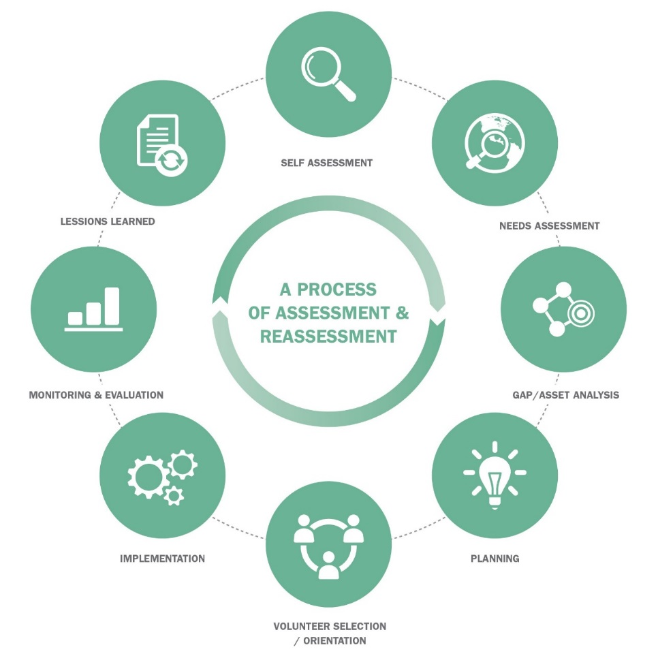
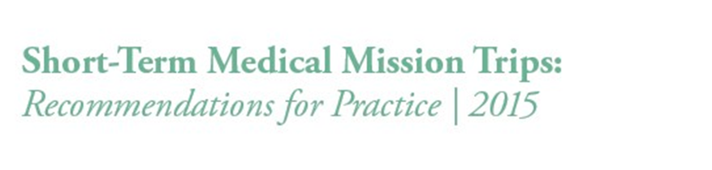
CHA Recommendations for Practice
Notes:
The desire to identify recommended practices is not just rooted in good professional practice. There is an ethical imperative that also drives the desire to improve short-term medical missions. If there are better ways to do this work than current practice and we are not intentional in pursuing them, then we are doing ourselves and the host communities a great disservice. While it may not be possible to prescribe what should always be done, we are able to take the perspectives from the U.S. and international partners to provide these Recommendations for Practice.
The recommendations are organized by way of a process for discerning your organization’s current or future short-term medical mission trips programs and processes. This process takes into account a process suggested by the World Health Organization (WHO) in its report, “Partnerships for safer health service delivery: Evaluation of WHO African Partnerships for Patient Safety 2009 – 2014.”

Slide 31

CHA Recommendations for Practice
Understand your organization’s history as it relates to international activities.
Ensure your motives are appropriate.
Identify the budgeted resources and the time frame for such support.
Notes:
QUESTIONS FOR REFLECTION:
What do we know about our organization’s history related to international and charitable activities (sponsor, health system, hospital, employee, related organizations)?
How will past activity affect our ability to do medical missions?
What has motivated us to consider doing an international medical mission?
How do our motives keep the international partner community as the focal point?
What resources (financial, personnel, technology, other) have we budgeted?
DECISION POINT :
Based on available resources and levels of commitment, move forward to conduct a needs assessment or reconsider involvement in this project.

Slide 32
Unite for Sight Online Programs
Increase your teams’ understanding of global health and global problem solving by using a variety of Unite For Sight's online programs which include: Global Health Online Course Cultural Competency Online Course Volunteer Ethics and Professionalism Online Course Social Entrepreneurship Overview Effective Health Education Rumors and Word of Mouth Overview of Spending at the Base of the Pyramid Photography and Ethics TED Video about cultural understandings and misperceptions

Slide 33
Unite For Sight Resources
Additional Unite For Sight Resources Related to Care Provision:
  The Importance of Avoiding Pitfalls in Global Health & Development
  Outcomes Are Essential In Global Health
  Global Health Delivery Challenges Course
  Clinic Challenges in Resource-Poor Settings Course
  Issues in Medication Management

Slide 34
Sample Guides:
Customs, Culture, and Etiquette
Guides from Kwintessential here.
Guides from e-Diplomat here.
Understanding Latin American Culture article here.
Countries and their Cultures website here.
Notes:
While some the Unite for Sight Global Health University modules do a great job of talking about cultural sensitivity, these are additional resources that can assist you with country specific customs, culture and etiquette. It is important to understand the similarities and differences in communication styles, language and the important issues related to customs culture and etiquette which are relevant in the country(s) you will be visiting. These customs will affect your experience. It is important to be aware of them and the feelings you might have on the trip. It is possible you could feel a sense of purposelessness or possibly even dominance – a sense that you have the answer. Likely neither is true, so it is important to ensure that you prepare yourself for a well-balanced interaction that provides you with the most productive and impactful opportunity. These guides to customs culture and etiquette can assist in your preparation.

Slide 35
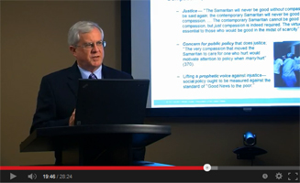
The Heart Which Sees:
On Being Neighbor
By: Ron Hamel, Ph.D.
CHA senior ethicist (retired)
What: Explores the Biblical story of the Good Samaritan and takes viewers through a theological reflection of this story and how it relates to today's realities, particularly in international outreach.
Length: Approx. 25 minutes
For: Board sponsors, executive leaders, formation groups, those who have or could participate in international missions/immersion trips.
» Watch the Video
» Download Facilitation Guide
Notes:
Suggestions for Theological Reflection and Formation Study
The following process is offered as an outline for discussion of the video. It provides suggestions for reflection and discussion on the challenges of international outreach. It is designed to be adapted to the needs of small or large groups such as boards, sponsors, executive leaders and formation groups.
1. Provide the group with the scripture passage (Luke 10:25-37). Ask one to read aloud. Invite responses to the following question:
Have you ever had a personal “Good Samaritan” experience, either on the receiving end or as the person who stepped in to help? What happened? What did you learn from that experience?
2. Show the video (28.23 minutes). Read this lead-in to the video:
In this video titled “The Heart Which Sees,” Ron Hamel, retired senior ethicist at the Catholic Health Association, explores the story of the Good Samaritan. He asks the question: “How are we to BE neighbors?” Consider the implications of this question in terms of international outreach as you watch and listen.
3. After the video, ask the group to think about and discuss one or more of these questions that are raised at the end. If it is a large group, you may assign the questions to different tables for discussion.
Who are the persons in need of urgent care today? What are the ways in which we, individually and collectively, are blind to or avoid the obvious needs of some persons?
What are the challenges to compassionate care in our time and in our situation?
What price are we willing to pay as individuals and organizations to ensure just and compassionate care?
How vigilant are we in assessing the justice implications of health system changes?
How do we balance response to the needs of individuals with responsible stewardship of shared resources and promotion of the common good?

Slide 36
Closing Remarks
We hope you find this sample orientation to be a useful tool in developing an orientation program for medical mission trips sponsored by your organization.
Please know that CHA will be of service to you as you implement your medical mission program.
Feel free to contact Bruce Compton at bcompton@chausa.org

