Slide 1
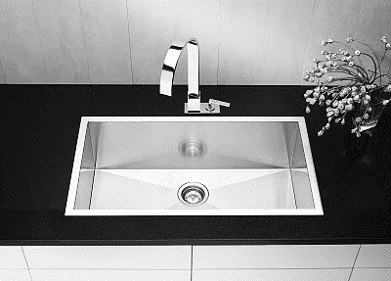
Another Kitchen Sink Survey from Klein & Partners:
What consumers think about a plethora of healthcare topics…
Presented by:
Rob Klein, President
Klein & Partners
October 22, 2014
Disclaimer: Please feel free to use these charts in any of your presentations; just cite Klein & Partners as the source of the information.

Slide 2
Introduction

Slide 3
Introduction
Background
The purpose of this nationwide quantitative survey was to understand consumers’ current thinking on a wide range of healthcare-related topics, including:
Methodology
A national online survey was conducted among 407 heads of household, 18 or older who are most responsible for healthcare decisions for themselves and/or the household. Interviewing was conducted from September 9 – 13, 2014. The sample frame used was Research Now’s online consumer panel. The final data set was weighted by geography, age, education, income, and ethnicity.
The total sample size of 407 yields a sample error of +/-4.1% at the 90% Confidence Level (CL). For example, if this study were repeated 100 times, in 90 times out of that 100 (i.e., 90% confidence level) we would find a total sample statistic of 50% to fall within approximately 46% and 54%.
Significant differences are called out in the charts using letters or arrows. Colors and bolding are used to highlight interesting patterns and/or findings.
Reactions to health reform Perceptions of health providers Tax exempt perceptions Perceptions of healthcare costs and profits Primary care physician Electronic medical record Medical home awareness and perceptions Concierge medicine Smart phone use | Interest in new information sources Communication methods used Choosing a hospital Websites visited Retail clinics used Online healthcare shopping behavior Transparency/price shopping Health insurance and getting care Rural healthcare perceptions

Slide 4
So what did we learn?

Slide 5
“Disruptive Expectations”

Slide 6

Reactions to health reform

Slide 7
And this is giving rise to the healthcare ‘customer.’
Q2: What do you feel is getting better or worse for you personally under healthcare reform?

Slide 8
2012
4%
15%
37%
17%
19%
8%
Significantly higher among college educated
Q3: Next we have a question about how health care eventually will be delivered under reform called an Accountable Care Organization or ‘ACO’.
Currently healthcare providers get paid when you, as a patient, receive care. Under reform, providers will be paid to manage the entire health of a population of people so they don’t get specifically paid when you need care, but they are paid a fixed sum to manage your health whether you ever get sick or injured or not. So their incentive is to keep you healthy and be cost effective in how they deliver care. And providers could include your local health care system of hospitals and doctors, a single hospital, even a large physician group, and they would be responsible for managing a large population of people in the community.
Based on this basic description of healthcare under reform, how comfortable are you in having this ACO manage all aspects of your health and wellness?

Slide 9

Tax exempt status

Slide 10
Support hospitals being tax-exempt
42%
41%
Q5: Do you support or oppose hospitals being exempt from paying state and local taxes?

Slide 11
Charging hospitals property and sales tax
Bad idea Not sure Good idea
Q6: As you may or may not know, many local communities and states are looking for ways to increase revenue to meet rising demands for services. One way that has been proposed is to treat local hospitals just like any other business in the community and charge them property tax and sales tax. Do you think this is a good idea or a bad idea?

Slide 12
Hospitals earning tax-exempt status
42%
35%
Q7: Would you say that hospitals in your area do or do not provide enough free medical care and health education services in your community to justify their tax-exempt status? Would you say they…?

Slide 13
Views on hospitals
2013
7% 20% 9% 40% 24%
Classic Catch-22
2013
4% 10% 6% 33% 47%
2013
12% 21% 11% 35% 22%
Strongly disagree Somewhat disagree Not sure Somewhat agree Strongly agree
Q8: Do you agree or disagree with the following statements?

Slide 14

Perceptions of healthcare costs and profits

Slide 15
Q10: In the current healthcare environment, do you believe your local hospitals are…?

Slide 16
Amount paid for services
Paid too much
Paid appropriate amount
Paid too little
Not sure
Q11: For each of the following organizations, please check if you think they are paid too much, too little, or an appropriate amount for the services they provide in today’s healthcare environment?

Slide 17
Perceptions of health providers

Slide 18
Don’t know enough to rate it
17%
14%
7%
23%
12%
9%
Q4: Next is a list of people or organizations that have been in the news lately. Please tell us how favorable you are towards each using a scale of 1 to 10 where 1 means very unfavorable and 10 means very favorable. Of course, you may use any number from 1 to 10.

Slide 19

Primary care physician

Slide 20


Primary care physician
Unchanged from past waves, more than eight in ten (82%) adults have a primary care physician. But it’s only 67% among those with HHI <$45K and only 60% among those 18-29.
Going online to rate a doctor or hospital has doubled in the past few years:
6% in 2009
9% in 2011
14% in 2012
12% in 2013
12% in 2014 (especially 18-44, college educated)
ZAGAT
Primary Care Doctor
Q12: Do you have a primary care or personal physician?
Q15: Have you ever gone online to a social networking site and shared your experiences about a doctor or a hospital you recently visited?

Slide 21
*
*Word-of-mouth!
*
*
*
*Significantly higher among Millennials
Q17: Thinking back to when you were first looking for a new primary care physician, which of the following sources of information, if any, did you seek out to help you choose that physician?
Q17a: Now, which one of these sources of information, if any, was most useful to you in choosing this physician?

Slide 22

Electronic medical records

Slide 23
Especially 21-44
Men →
Women →
Use EMR – 12%
Haven’t used yet – 3%
Q21: How interested would you be in having online access to your own personal health record – called an Electronic Medical Record (or Patient Portal) – to track your own health through a secure website that only you and your doctor and hospital can access?
Q22: Which of the following features, if any, would you definitely be very interested in accessing or have accessed through your electronic medical record? [Among those very interested or already have access]
Notes:
Seniors least likely to call for pricing (12%)
Parents more likely to call for pricing (39%)
Gen Y (37%)most likely to call for ER/Urgent care pricing
Baby Boomers most likely to call for Radiology (34%) and GI procedure (28%)
Gen Y (50%) and lower income (48%) more likely to choose the least expensive provider

Slide 24
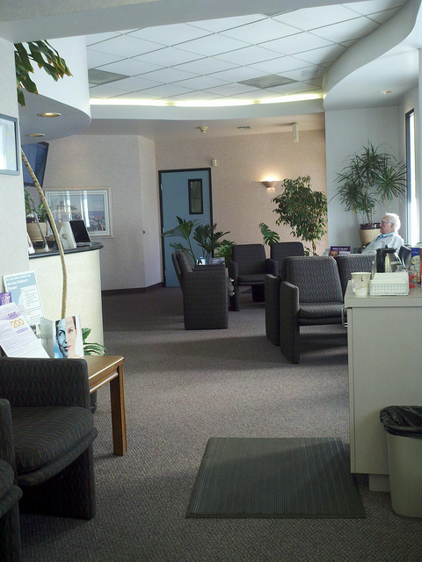
Medical home awareness and perceptions

Slide 25
5% believe they are part of a Medical Home with their physician (3% in 2012) which equals <1% of the adult population.
Consistent with other Klein & Partners research, half (55%) learned about a ‘Medical Home’ after they chose that physician.
(53% in 2012).
And when asked if they see any difference in their relationship with their physician because of the Medical Home program, 60% said yes. (new Q in 2014)
Q23: Prior to this survey, were you familiar with the term ‘Medical Home’ or what also is called a ‘patient-centered medical home’ which is a team-based healthcare delivery model led by the physician?
Q24: Are you part of a Medical Home through your primary care doctor?
Q25: Did you choose your doctor because he/she was part of a Medical Home or did you learn about that after you choose your doctor?
Q26: Do you notice any difference in your relationship with your physician because of the Medical Home program?

Slide 26

Smart phones
‘Can you hear me now?’

Slide 27
Any of these uses is significantly higher among Millennials.
Q31: Next, have you used a smart phone (e.g., Droid, iPhone, Blackberry, or any phone that can access the Internet) to go online and do any of the following…?

Slide 28

Communicaton methods

Slide 29
2013
4%
3%
2%
3%
91%
91%
3%
3%
Facebook visitors are almost entirely Millennials
Q37: In the past year, have you visited and/or ‘Liked’ a health plan or hospital Facebook page?

Slide 30
Q38: Have you ever had a ‘virtual doctor visit’ where you talk with a physician face-to-face using a PC, tablet, or smart phone?

Slide 31
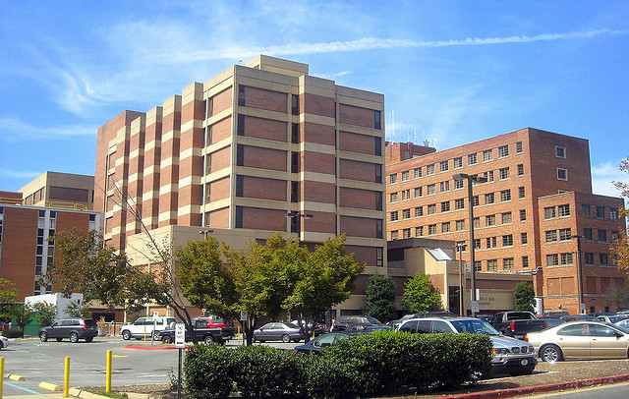
Choosing a hospital

Slide 32
Those who have not been to a hospital ‘think’ they would investigate their hospital choice a great deal more than what actually happens in a hospital choice scenario. The only real constant is ‘physician recommendation.’
Q39: Have you personally been to a hospital for inpatient, outpatient, or ER care in the past 2 years?
Q40: (Q39 Yes) Next, think back to when you were hospitalized and had to decide which hospital you should choose. Which of the following sources of information, if any, did you seek out to help you make that choice? (Q39 No) Next, if you had to be hospitalized and you wanted to gather information about which hospital you should choose, which of the following sources of information would you definitely use to help you make that choice?

Slide 33
Q41: Now, if you were looking for information on hospital quality to compare different hospitals before you made a decision on which hospital to choose, which of the following sources of quality information, if either, would you more likely find useful in your decision-making?

Slide 34

Websites visited

Slide 35

Been to a hospital website in the past 3 months: 11%
Q42: Have you been to a hospital website in the past 3 months?
Q43: Think about the most recent hospital website that you visited. What were your main reasons for visiting this website?
Q44: Overall, how well did this website meet your needs? Was this website visit…?

Slide 36
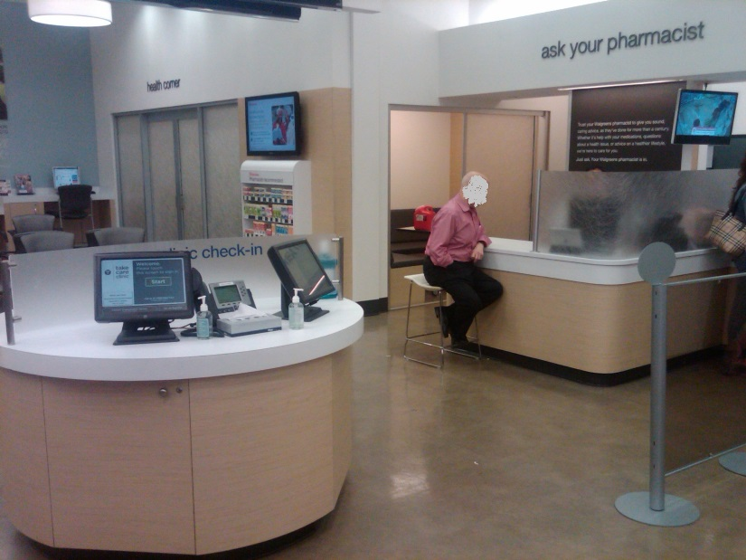
Retail clinics

Slide 37
Q45: Next, we have a couple questions about getting healthcare services or products at a retail store. Have you been to a {RESTORE RETAILER} for any of the following?

Slide 38

Price shopping

Slide 39
Price check in aisle five!
 | 2008 | 2009 | 2010 | 2011 | 2012 | 2013 | 2014
Households that have contacted a healthcare organization to ask the price for a specific visit, test, treatment, or surgery | 33% | 32% | 32% | 22% | 28% | 24% | 16%
Chose the least expensive provider for one of these healthcare cases | 36% | 41% | 31% | 31% | 33% | 24% | 44%
% of the total patient market → | 12% | 13% | 10% | 7% | 9% | 6% | 7%
Called:
2013 73%
2012 72%
2011 71%
Q50: Within the past year, did you or did a member of your immediate household contact any healthcare organization, hospitals, or physician offices to ask about the price for a specific visit, test, treatment, or surgery? IF YES…
Q51: How did you check on pricing?
Q52: What type of health service did you ask about pricing for?
Q53: Did you end up choosing the least expensive provider?
Notes:
Seniors least likely to call for pricing (12%)
Parents more likely to call for pricing (39%)
Gen Y (37%)most likely to call for ER/Urgent care pricing
Baby Boomers most likely to call for Radiology (34%) and GI procedure (28%)
Gen Y (50%) and lower income (48%) more likely to choose the least expensive provider

Slide 40

Healthcare and financial hardships

Slide 41

Especially among those <$45K HHI (25%) and Millennials (23%).
Q55: Have you experienced a significant financial hardship in the past year due to medical bills?

Slide 42

Additional information
If you would like additional information regarding this study, please contact:
Rob Klein
President
Klein & Partners
[630] 455-1773
rob@kleinandpartners.com

