Slide 1
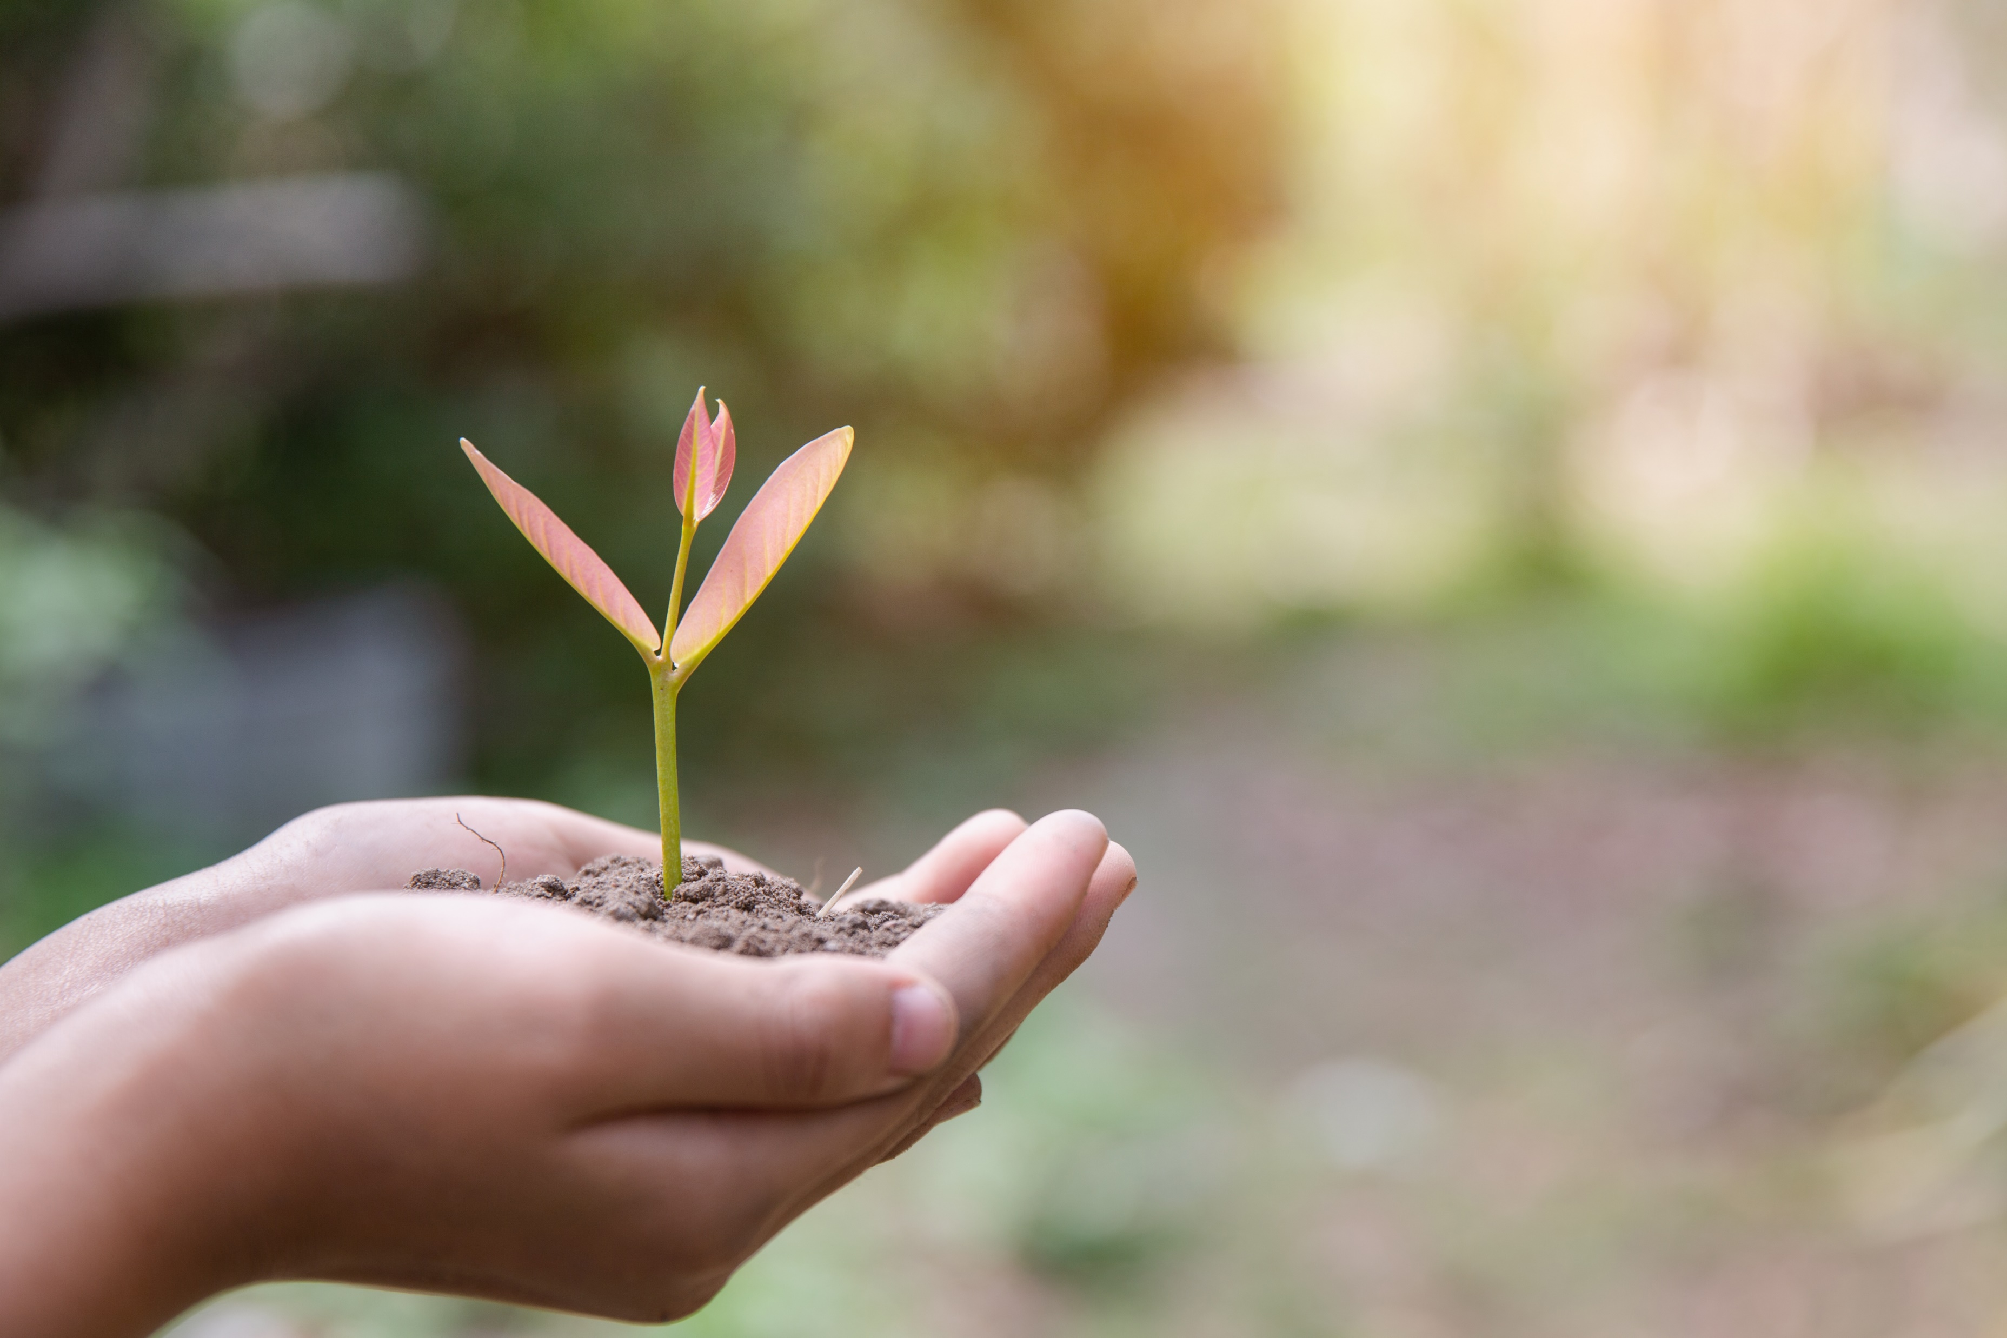
A Reflection for Earth Day
God,
Creator of All,
We offer our prayer in gratitude and humility that we might heed your call to care for one another through our care of the least, the lowest and the most vulnerable of all your blessed creation.
Grant, we pray, the courage to speak on behalf of the soft soil under our feet, the running and still waters, the warmth of the sun on our face, and all the crawling, flying and swimming creatures you love. May our courage to speak translate into actions that protect our planet – so that our children and their children might enjoy the fruits of what we sow.
In your name, we pray.
AMEN.

